Slide 1
Saving Energy, Saving Money - Helping Manufacturers Set and Achieve Big Goals
Eli Levine
Office of Energy Efficiency and Renewable Energy

Slide 2

Manufacturing – Why do we care?
Manufacturers spend $200 Billion/year on energy to operate their plants
DOE data demonstrates most plants have big opportunities to reduce energy use with relatively short payback periods
Important for Resiliency, Competitiveness, Workforce
Notes:
**if approved, need to purchase and replace stock image**

Slide 3
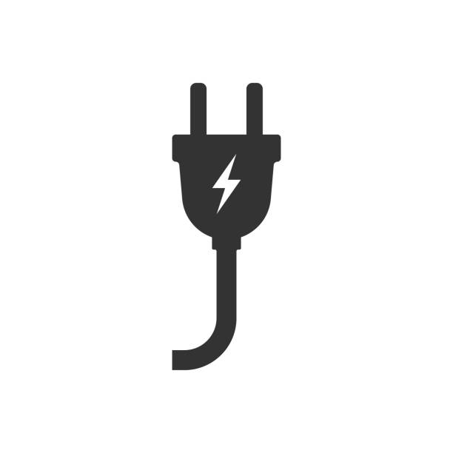
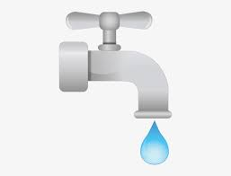

DOE’s Better Plants Program
Helping manufacturers and other industrial organizations save money and improve their competitiveness
Increased
Energy Productivity
Water
Savings
Waste
Reduction

Slide 4
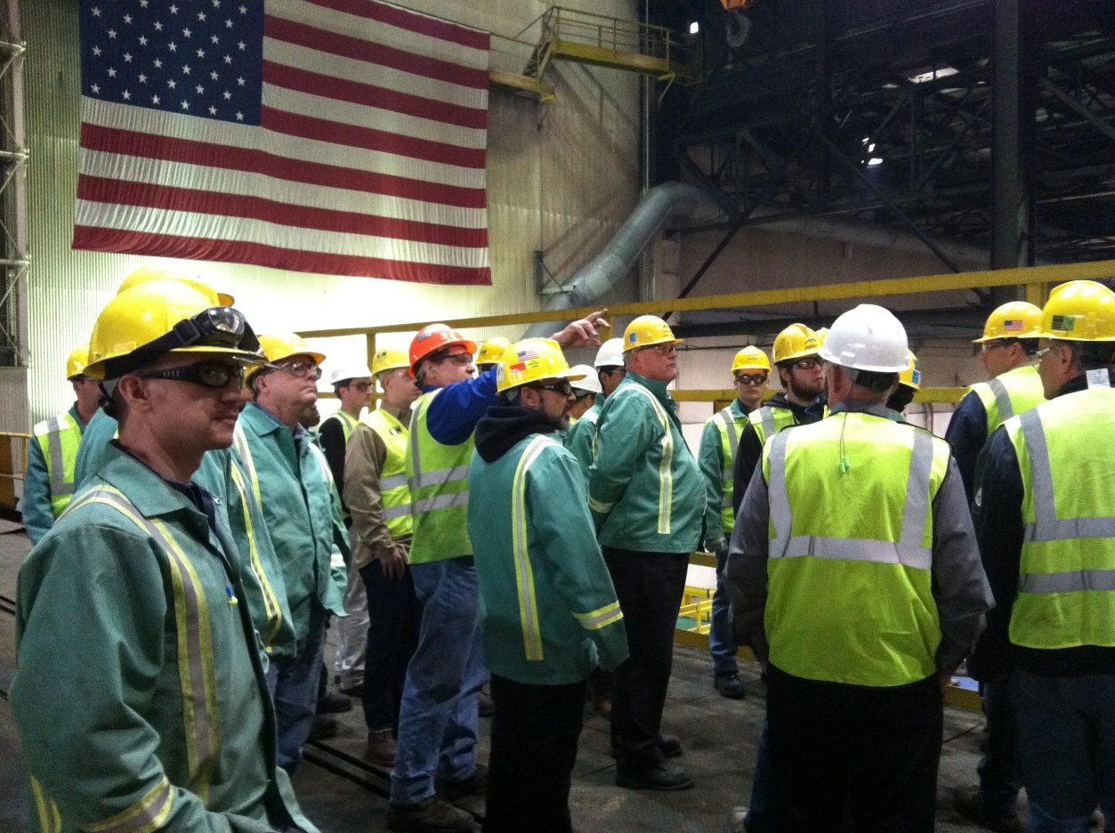
How Does Better Plants Work?
Voluntary and Free to Participate
Partners set long-term strategic goals
DOE works with you to achieve your goal

Slide 5
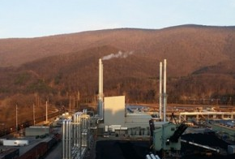
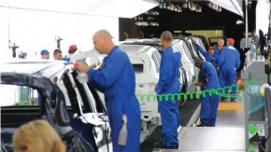
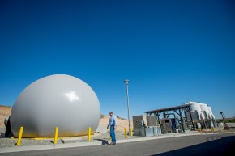
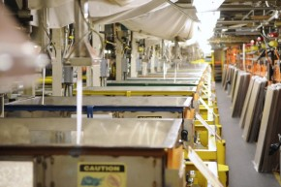
Better Plants Year in Review
To Date, Better Plants Partners Have Cumulatively Saved:
6.7 Billion Dollars
1.3 Quadrillion BTUs
Today:
230+ partners
3,200 facilities
12% of U.S. Manufacturing Energy Footprint

Slide 6










































































































































































What Market Leadership Looks Like

Slide 7







Better Buildings, Better Plants Partners Are:
32 of the
Fortune 100 Companies
28 state governments
90 local governments
30% of all Commercial Building space
8
National Laboratories
12% of the U.S.
Manufacturing
Energy Footprint
12 of the
Top 25 U.S. employers

Slide 8

Why Companies Join Better Plants
Industry Leadership
Technical Assistance Resources
Developing Innovative, Replicable
Solutions with Market Leaders
National Recognition
Peer to Peer Networking
Better Building Solutions Center
Making Energy Efficient Investments Easier
Tools for Energy Management
Financing Navigator
Diagnostic Equipment Program
Emerging Technologies
Workforce Development
Innovation to Drive Savings
DOE National Labs
Advanced Technology Field Validation
Helping You Meet Your Challenges of Today, and Tomorrow
In-Plant Trainings
Industrial Assessment Centers

Slide 9
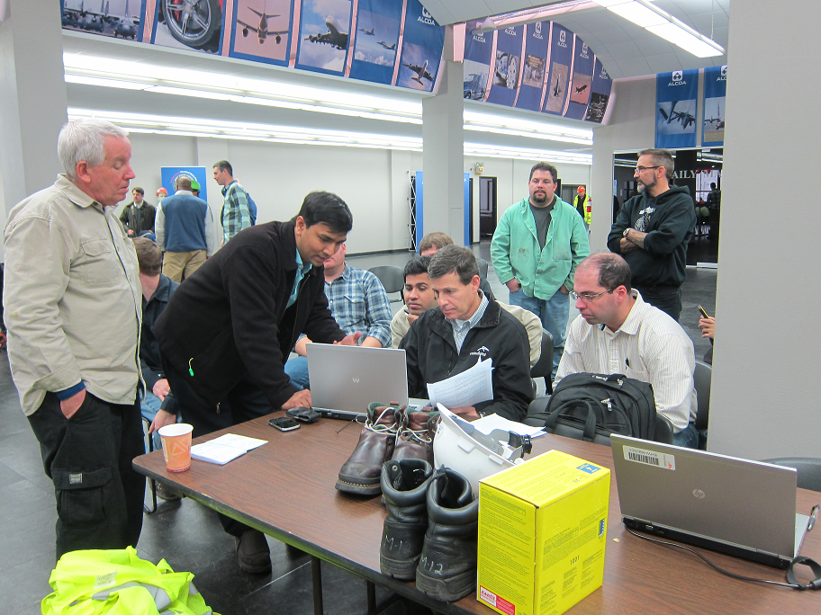
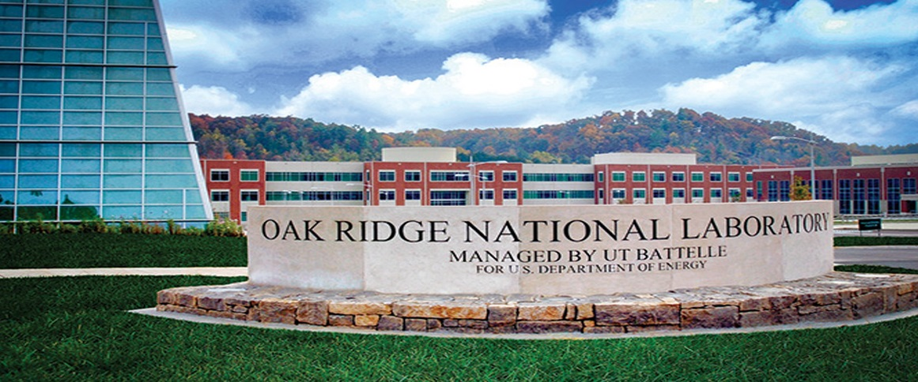
Technical Assistance: Technical Account Manager
  Helps Partners develop a roadmap to achieve their goals
  Helps Partners set energy baselines, track data, and identify energy savings opportunities
  Inform about DOE and external resources
“Like having a free consultant on retainer”
--Andy Terrey, City of Phoenix Water Services

Slide 10
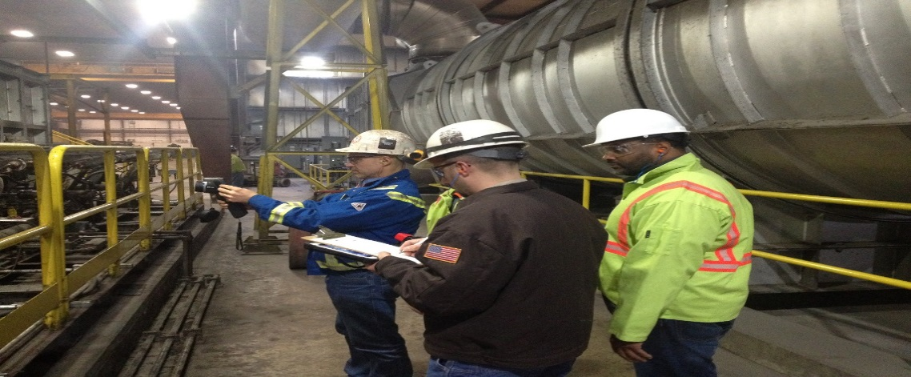
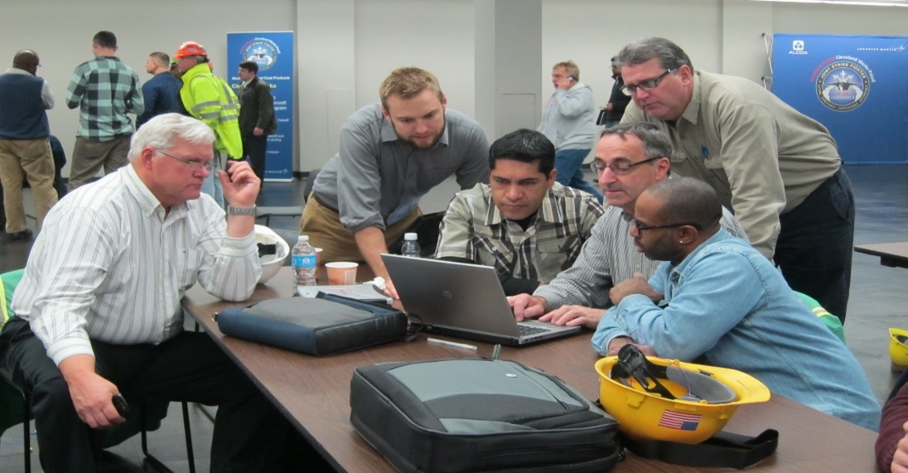
Technical Assistance: Tools and Resources
Diagnostic Equipment Program
MEASUR Tool Suite
How can we help you evaluate system performance, measure energy losses and quantify savings opportunities?
https://www.energy.gov/eere/amo/measur
Notes:
AMO suite of industrial system software platforms:
Measure energy losses
Quantify savings opportunities
Developed by national experts
NEW: Plant Water Profiler tool
All system level software tools available through one platform
Includes system modelers and individual calculators for field validation
Includes built-in guides and tutorials

Slide 11
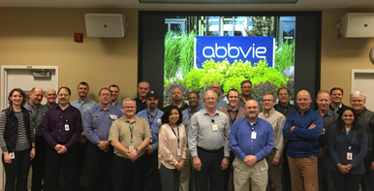
Technical Assistance: In-Plant Trainings
Teach plant workers how to conduct assessments, use DOE tools, and implement projects
120+ In-Plants, 2100 participants since 2011
Identified more than $40M in energy savings
Pumping Systems
Fans
Compressed Air
Motors
Processed Heat
Industrial Refrigeration
Water/Wastewater Treatment
Water Efficiency
Energy Treasure Hunt
In-Plant Training Topics:
Notes:
Compressed Air
Pumping
Steam
Process heating
Fans
Energy Treasure Hunt Exchanges
Water/Wastewater treatment
Industrial Refrigeration
50001 Ready

Slide 12
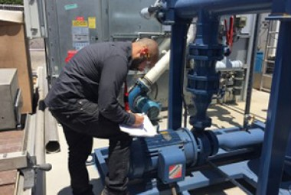





Technical Assistance: Supply Chain Initiative
Around 40-60% of a manufacturing company's energy and carbon footprint can reside upstream in its supply chain.
DOE works with partners in its Supply Chain Initiative to encourage their suppliers to leverage Better Plants resources, and collectively set, track, and meet energy savings goals.
Not Just Goal Setting – Technical Assistance to Get there

Slide 13
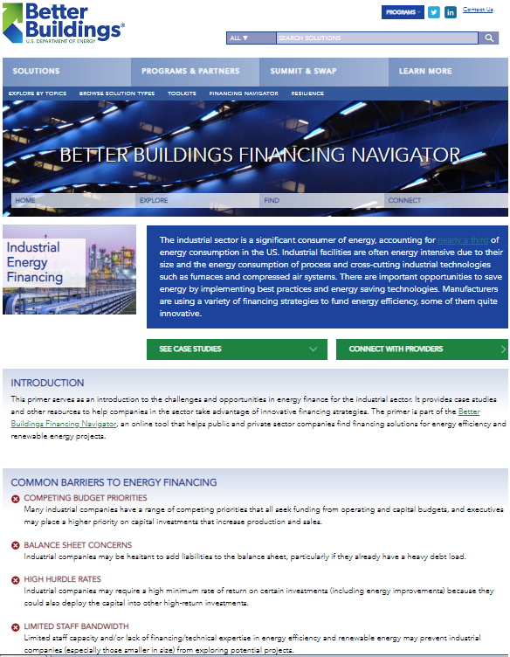
Better Plants Financing Navigator
New Industrial Energy Financing Primer
  Common Barriers
  Common Financing Solutions
  Alternative Financing Solutions
  Financing Considerations
  Case Studies
  Additional Resources
  https://betterbuildingsinitiative.energy.gov/financing-navigator

Slide 14




Technical Assistance Complementary Programs

Slide 15
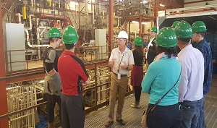
Emerging Technologies
Partners visit DOE National Labs to:
Tour World-Class Lab Facilities
View Demonstrations of innovative Technologies
Hear from Experts from the Lab and Industry
Learn how to easily partner and leverage technology
Network with BP partners and lab technologists
https://betterbuildingssolutioncenter.energy.gov/labs

Slide 16
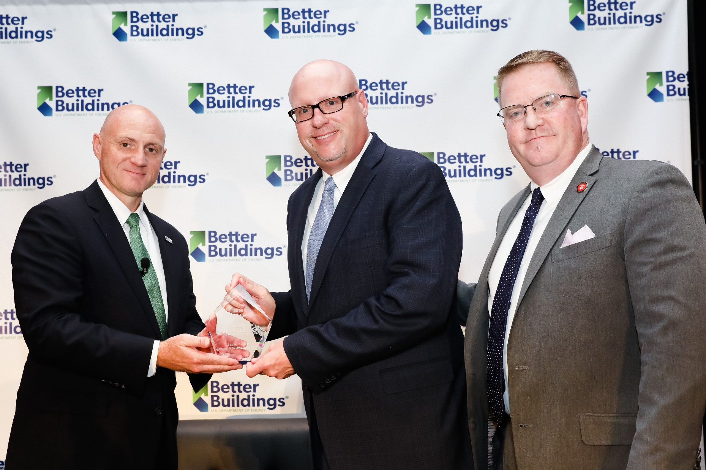
Recognizing and Amplifying Leadership
To date, Better Plants has recognized 60 goal achieving partners

Slide 17
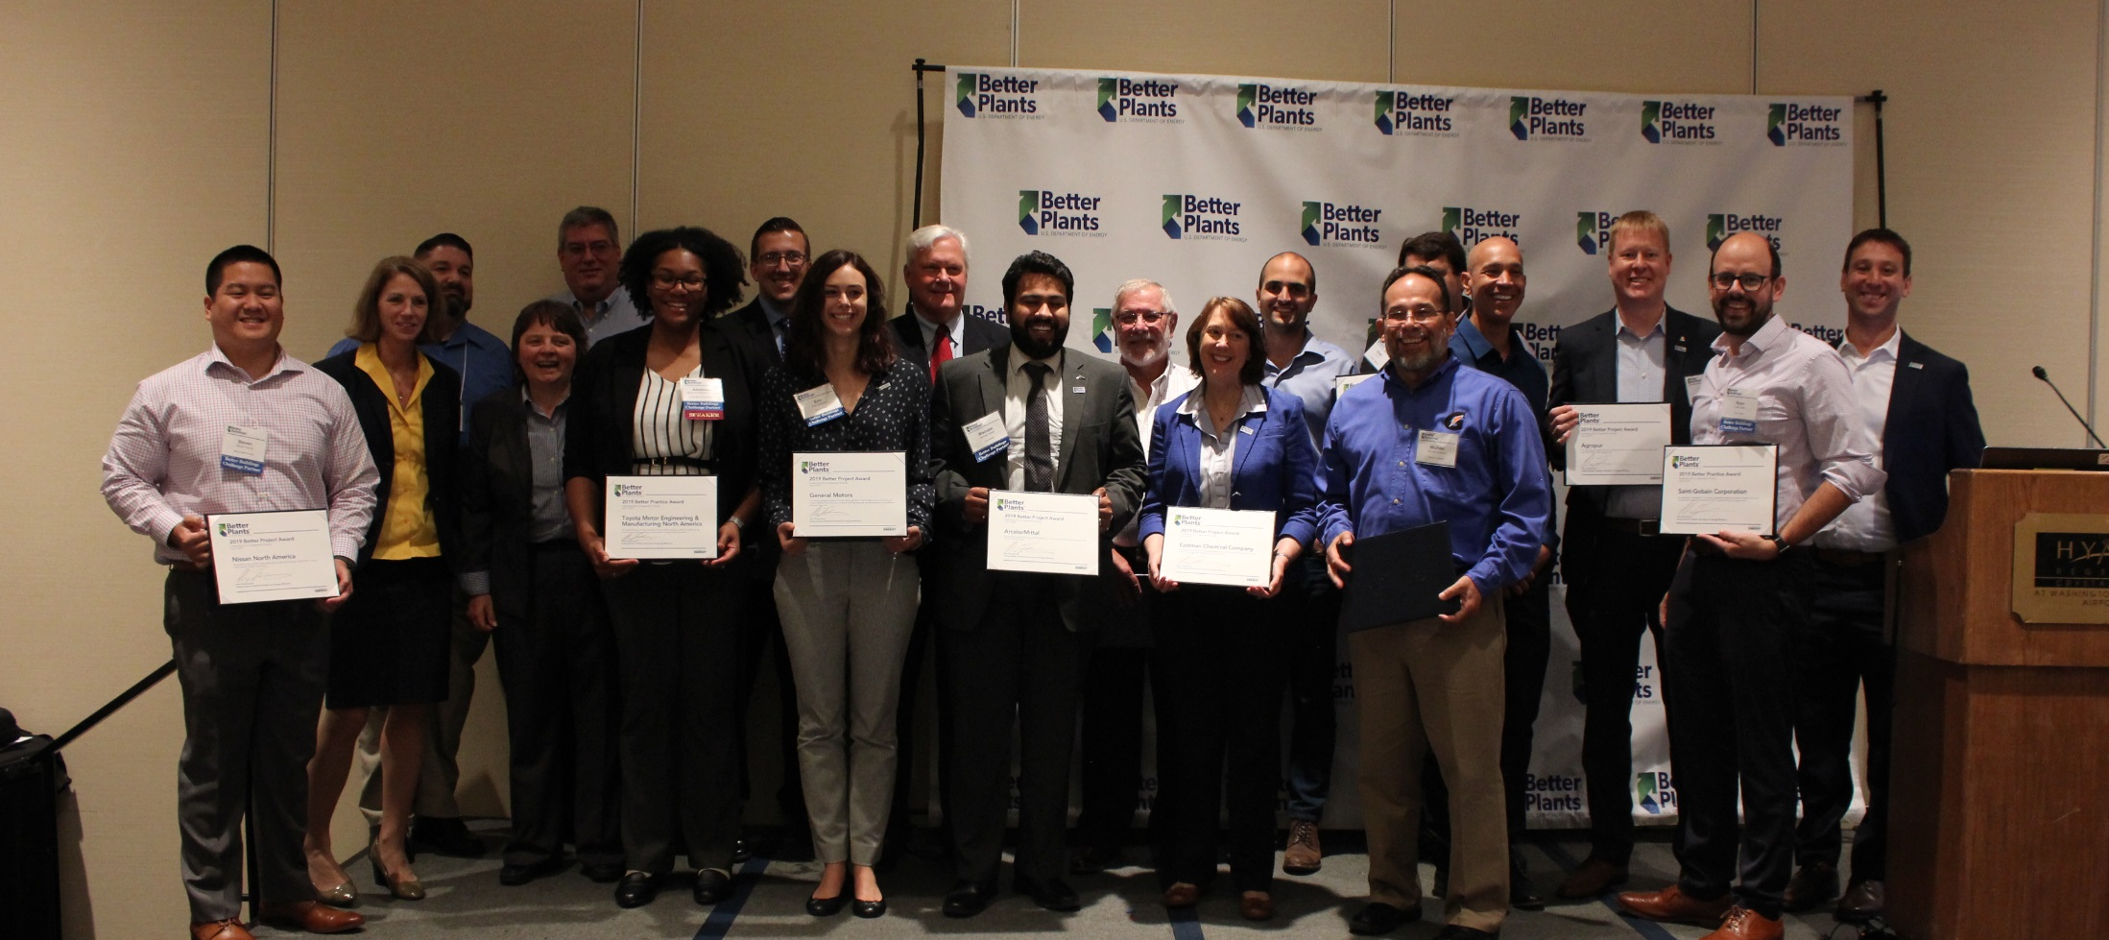
Recognition: Better Practice and Project Awards

Slide 18
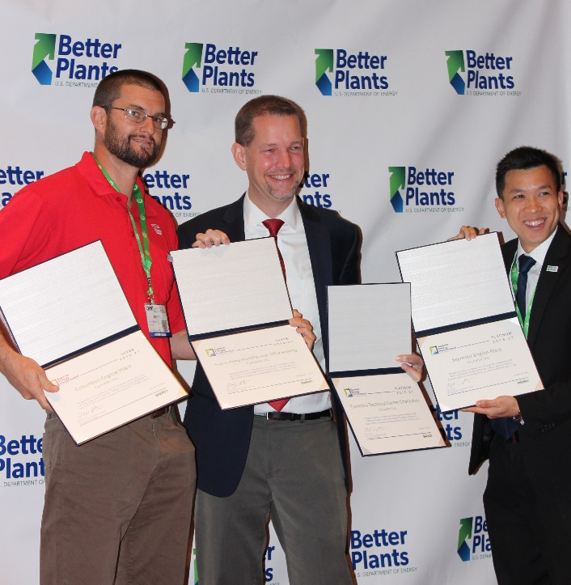
National Recognition – New Prize
Individuals Taking Energy Action in Manufacturing (ITEAM) Prize
$5,000 to 5 winners in each of small, medium,
large categories.
DOE is launching the ITEAM Prize competition as a means to:
Find individuals who were responsible for creative, specific, and innovative ideas and practices that led to significant, measurable energy savings at their manufacturing facilities; and
Encourage those individuals to widely share their ideas and practices for the benefit of U.S. Manufacturing facilities nationwide.

Slide 19
4 Things all Better Plants Goal Achievers Did
1
Gained senior management commitment
2
Engaged the entire organization and communicated about results
3
Established strong metrics and a consistent data tracking system
4
Implemented cost effective measures, then look deeper; evaluated
best practices & latest technologies; implement them strategically

Slide 20
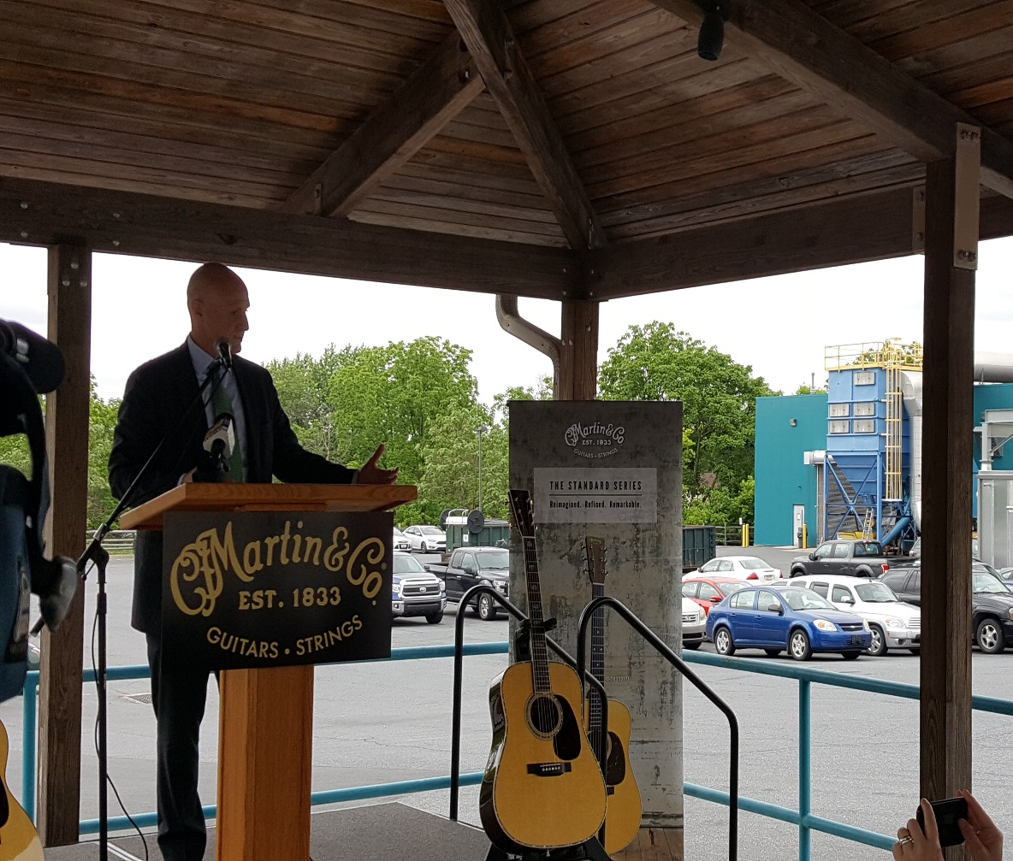
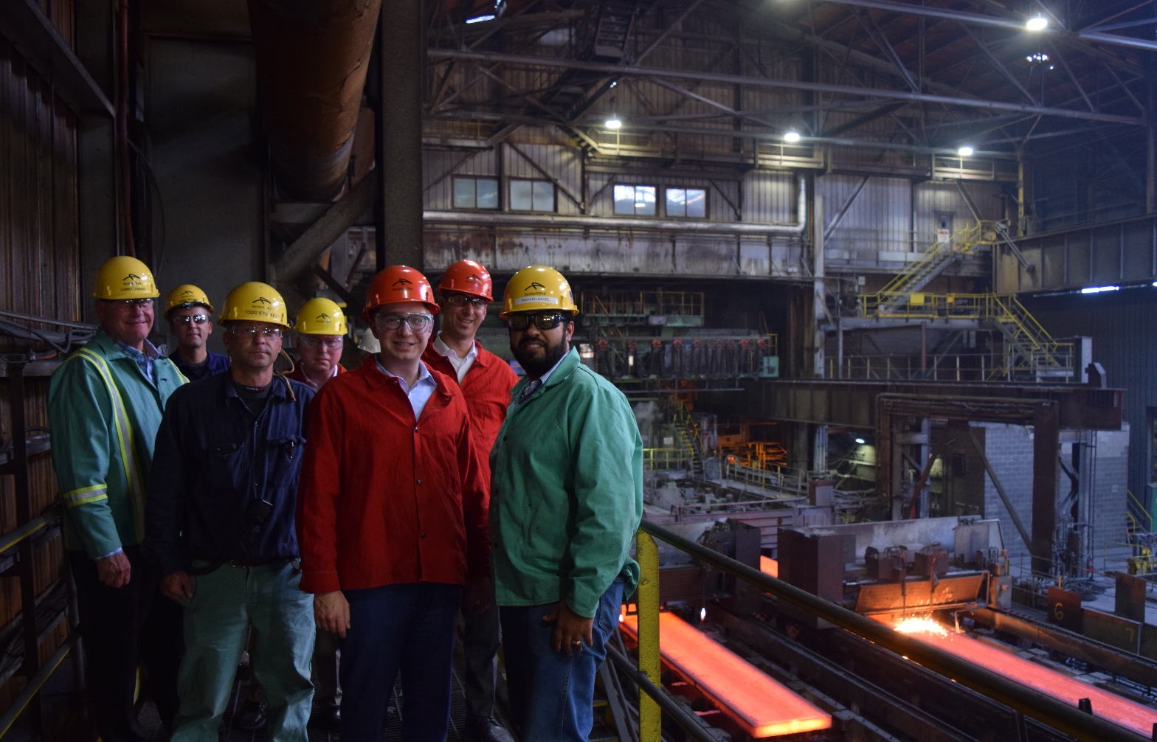
National Recognition: Helping You Tell Your Story

Slide 21
National Recognition: Helping You Tell Your Story

Slide 22

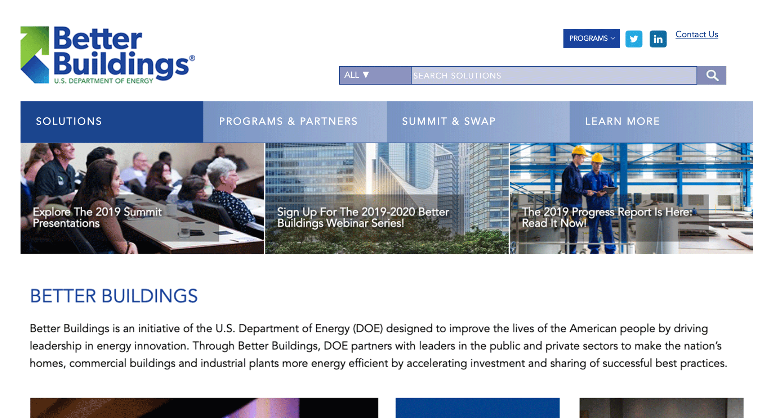
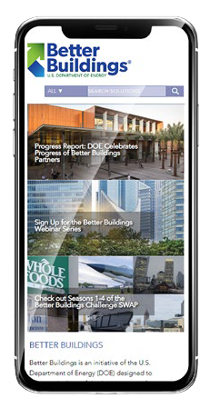
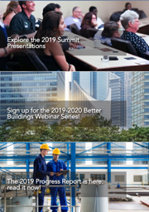
Better Buildings Solution Center
More than 2,500 solutions are available publicly in the Better Buildings Solution Center
  Showcase Projects:
    Successful Energy Savings Case Studies
  Implementation Models (Playbooks):
    Overcome barriers: finance, data, energy management, staff training, partnering with utilities, and more
    Multi-faceted and applicable across sectors
  Technology Focus Area Pages
    13 focus areas, from compressed air to renewables
    DOE tipsheets and publications, software tools, webinars, and contact information for a subject matter expert
  Additional Resources, Toolkits, Case Studies
energy.gov/bbsc
Notes:
Animated screen

Slide 23
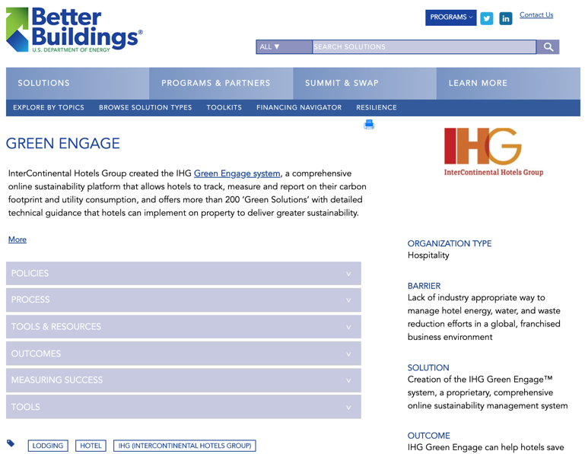

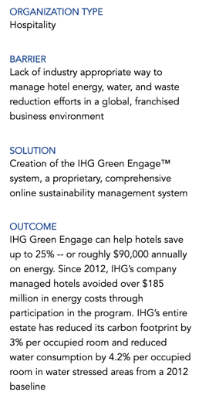

More than 200 Partner Playbooks
≠
Financing or paying for a project
Engaging employees, occupants, and customers
Motivating my organization
Building expertise within my organization
Using data (or technologies) to track progress
Getting access to data and information
Reaching my community
Identifying or evaluating energy-saving technologies
Metering/measuring energy use
Partnering with my utility
Acquiring expertise outside of my organization

Slide 24
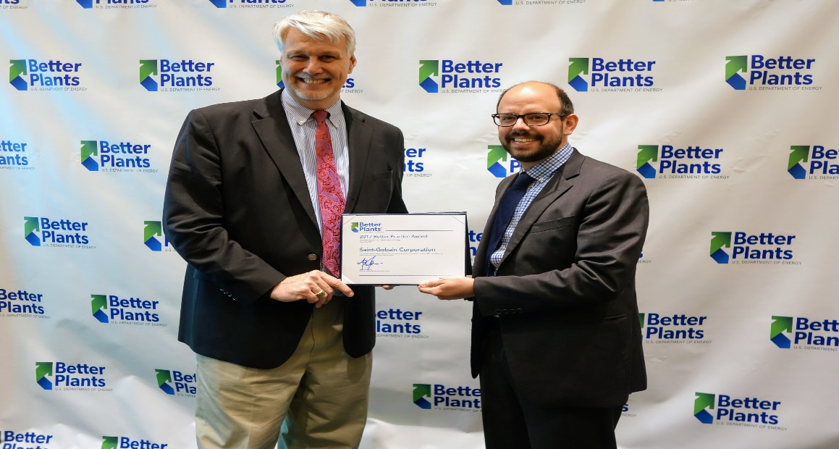

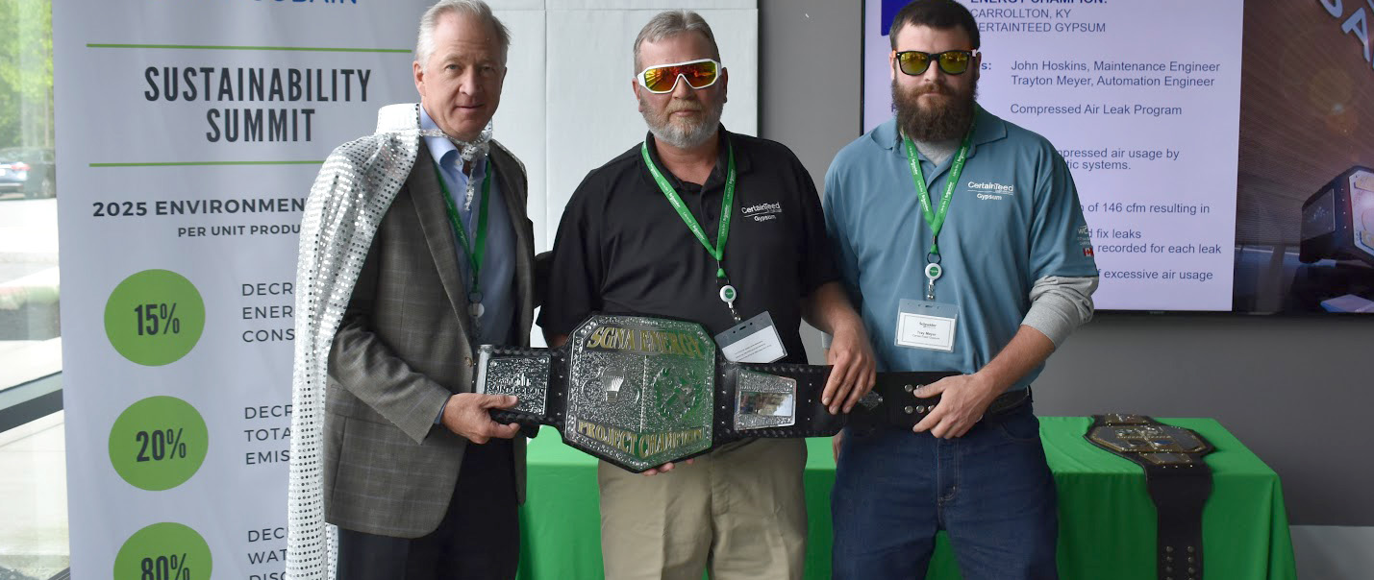
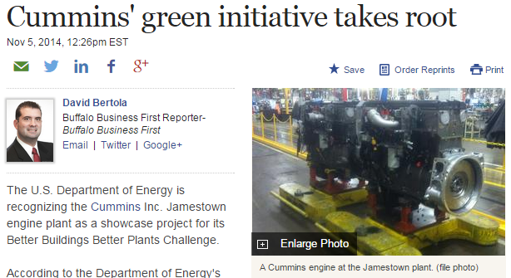
National Recognition: Helping You Tell Your Story

Slide 25




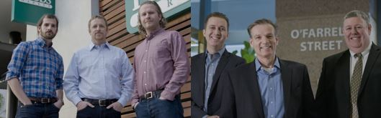












Better Buildings Challenge SWAP
Season 1
Season 2
Reaching Media, Making Headlines
Widespread Outreach
14+ Million Views
Can a Reality TV Show Help Cut America’s Power Bill?
2/17/2016
The Department of Energy’s Reality Show Makes Energy Efficiency Fun 4/25/2017
26 Million Impressions
85 Million Media Impressions
Season 3
Season 4

Slide 26
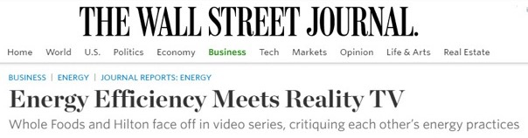

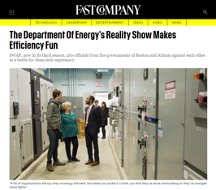
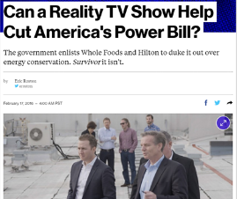
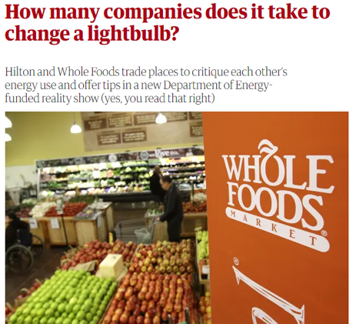
Better Buildings Challenge SWAP
Widespread Outreach
14+ Million Views
26 Million Impressions
85 Million Media Impressions

Slide 27
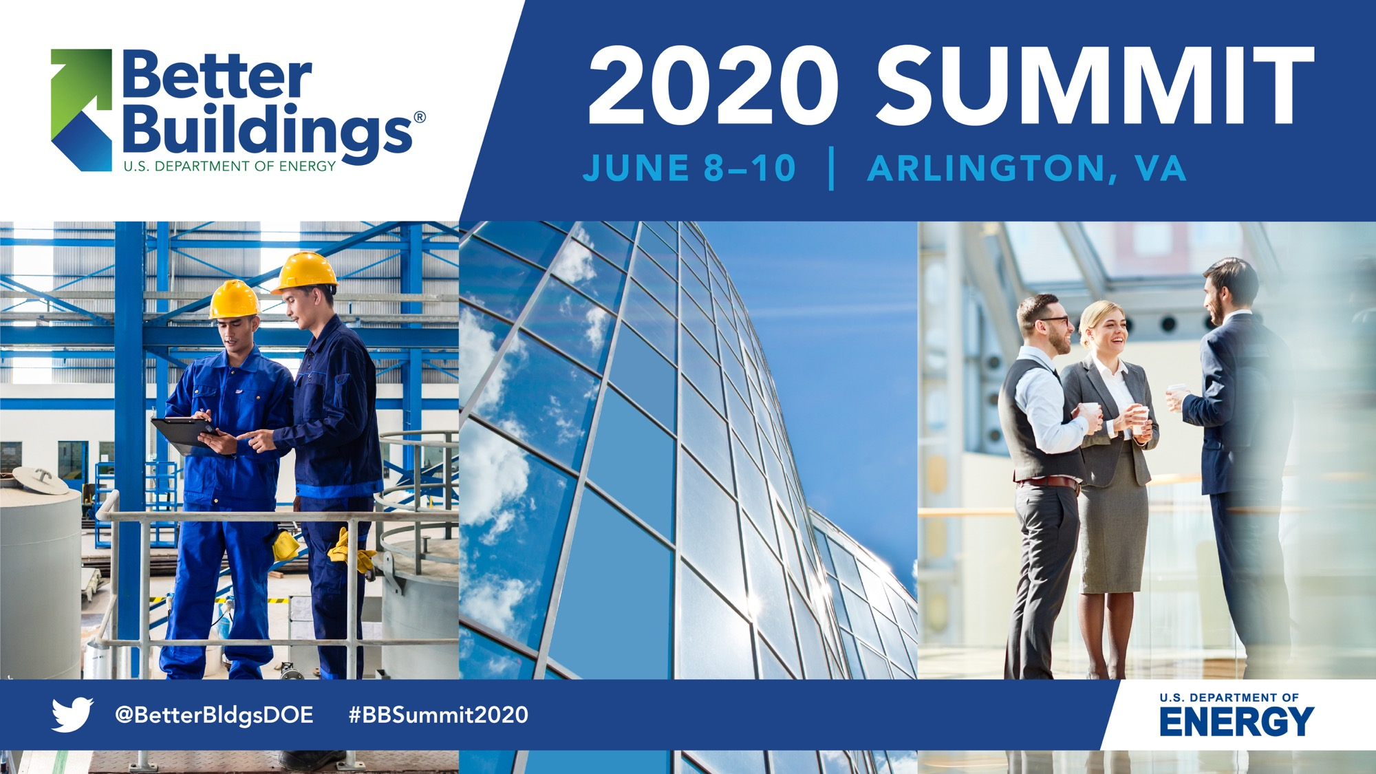

Slide 28
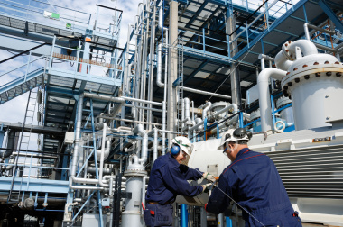
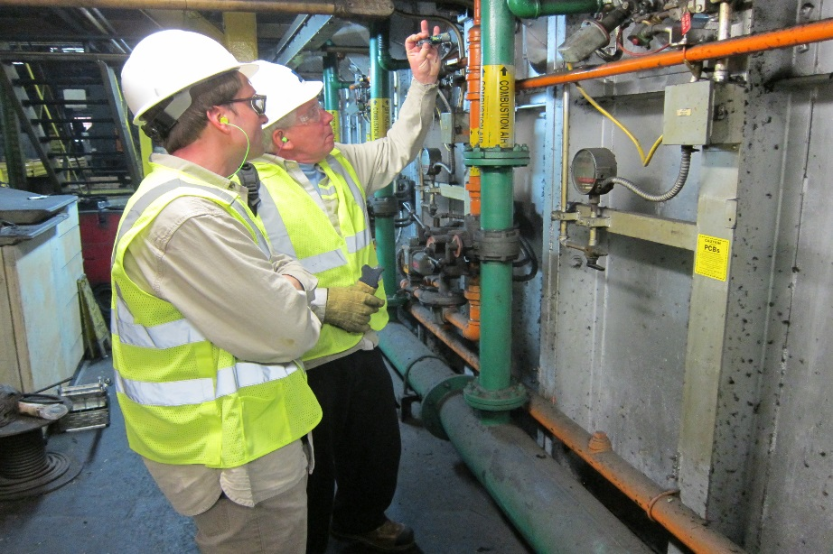
Why Partner with Better Plants?
Consider Partnering If:
Energy is a significant part of operating costs
Want/Need Technical Assistance with energy efficiency
Networking with industry-sector peers & independent experts is helpful
Recognition for energy efficiency/sustainability accomplishments is desired

Slide 29
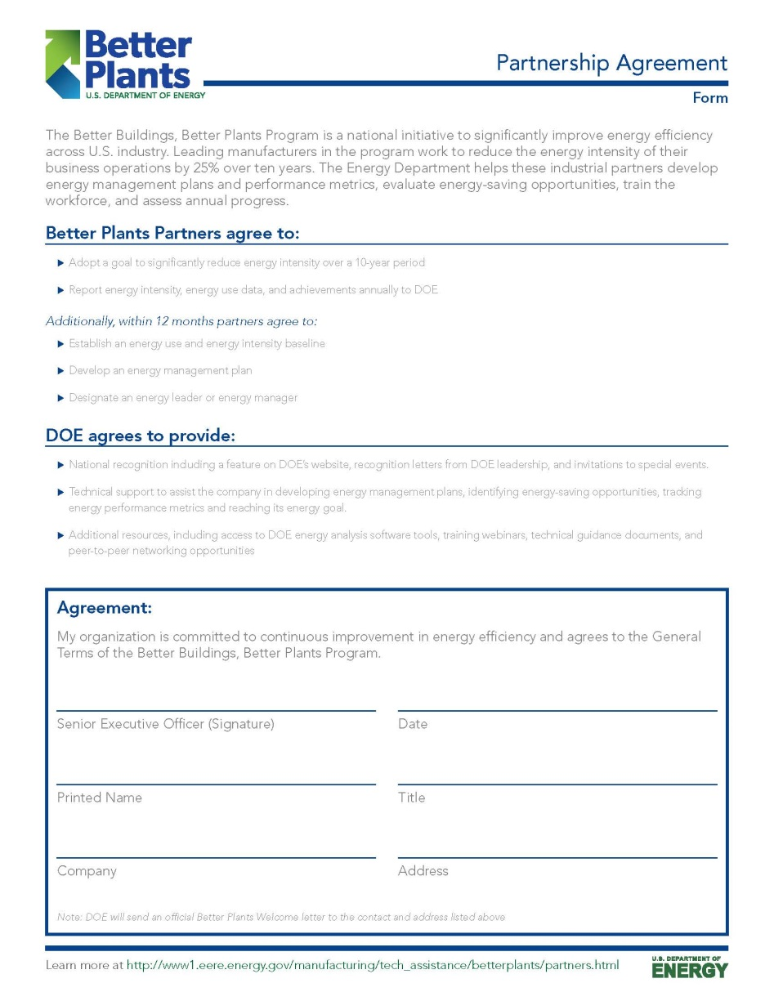
Joining is Easy!
Simple 2-page agreement
Should be signed by CEO or a senior executive
Fill out and email back to: betterplants@ee.doe.gov

Slide 30
Thank you!
For More Information:
Eli Levine, eli.levine@ee.doe.gov , 202-586-9929
Better Plants Website:
http://betterbuildingssolutioncenter.energy.gov/better-plants

