Slide 1
Alliant Energy Wisconsin update
WIEG Board Meeting
October 26, 2018

Slide 2
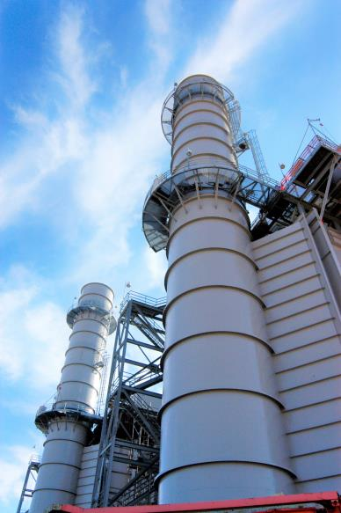
Rate settlement
Riverside Energy Center
Base rates frozen through 2020
Reduced Riverside Energy Center gas rate = electric fuel savings
Reduced Second Nature premium
Additional service adjustments to be addressed later this year by PSCW
Late payment fee
More days until bill due date

Slide 3
Key activities
Tax reform
Enable settlement
One-time credit in July
Per kWh credits through end of 2018
Fuel adjustments
2017 true-up
2019 fuels (no customer rate change)

Slide 4
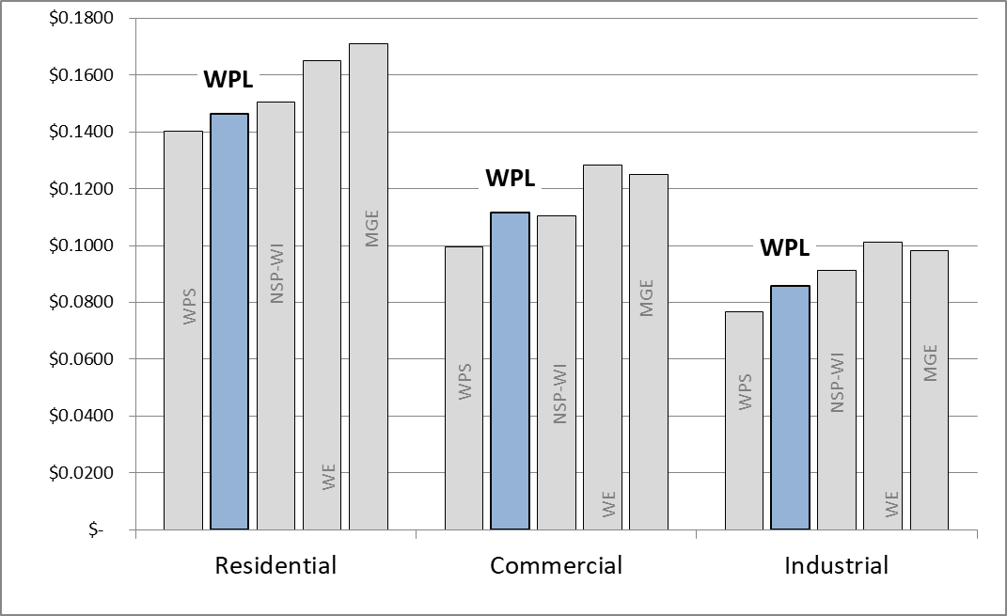
Competitive pricing
Comparison of Wisconsin IOUs as of January 2018, using standard use profile

Slide 5
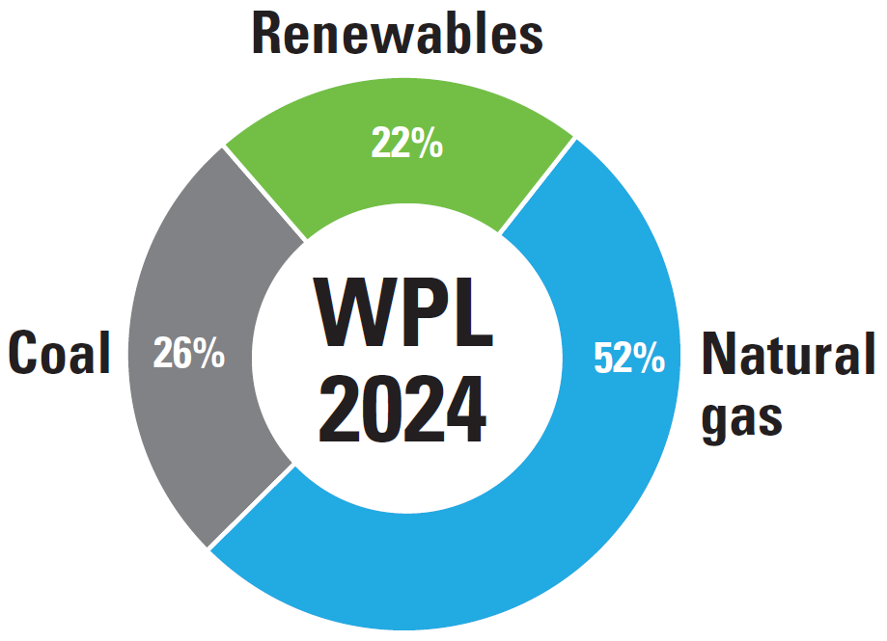
Transitioning our energy resources
West Riverside Energy Center
Forward Wind Energy Center
Kossuth Wind Farm
Corporate Sustainability Report
New 2050 goals
Eliminate all existing coal from energy mix
Reduce carbon dioxide emissions by 80%

Slide 6
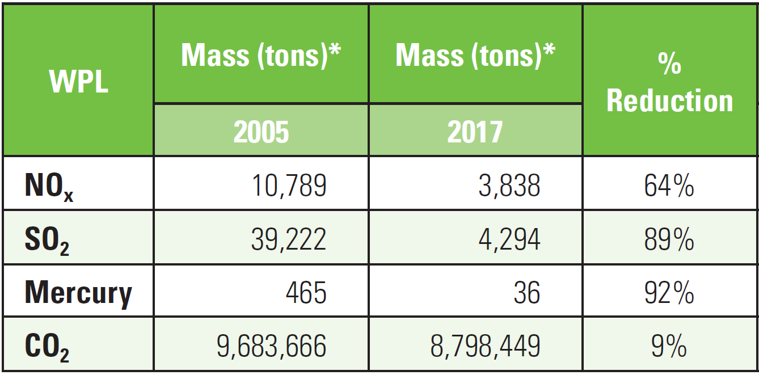
Emission reductions = cleaner air
Installation of air quality control systems
Fossil-fuel unit retirements

Slide 7
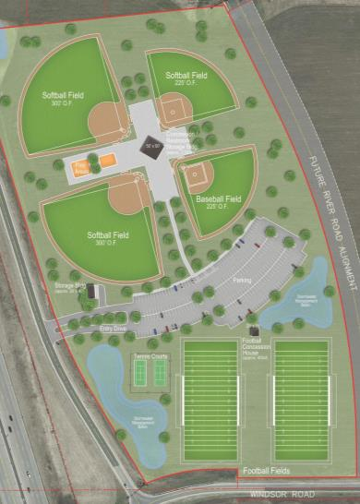
Supporting strong communities
Beaver Dam Commerce Park
520-acre site for large projects
Boost job creation and electric load
DeForest Star City Partnership
Spur growth through use of energy efficient technology and electrification
Electrification
Residential and commercial customer rebates for EV charging stations and non-road electrification uses, such as forklifts
DeForest Athletic Complex

Slide 8
Options: Not “one size fits all”
Options that meet customers specific objectives
Developed through collaboration of utilities, customers and regulators
Examples
Renewable options
Market-based pricing
Economic development rates
Individual contract

Slide 9
Appreciating the partnership
Rich history of collaboration with WIEG and our customers
Look forward to continuing customer outreach

