Slide 1
Projects and Policy Issues Update
Brian C. Drumm, Manager-Regulatory Relations & Policy
and Associate General Counsel
June 6, 2018

Slide 2
Who am I?
ATC’s Manager of Regulatory Relations & Policy
  Leading a team of professionals that monitors federal regulatory policy developments at FERC as well as the MISO stakeholder process
    Disseminate
    Collaborate
    Respond
Formerly ATC’s FERC Attorney (2013-2017)
  DTE Energy (2009-2013)
  Washington D.C law firms (2001-2009)
J.D., Indiana University (Bloomington), MBA Marquette University

Slide 3
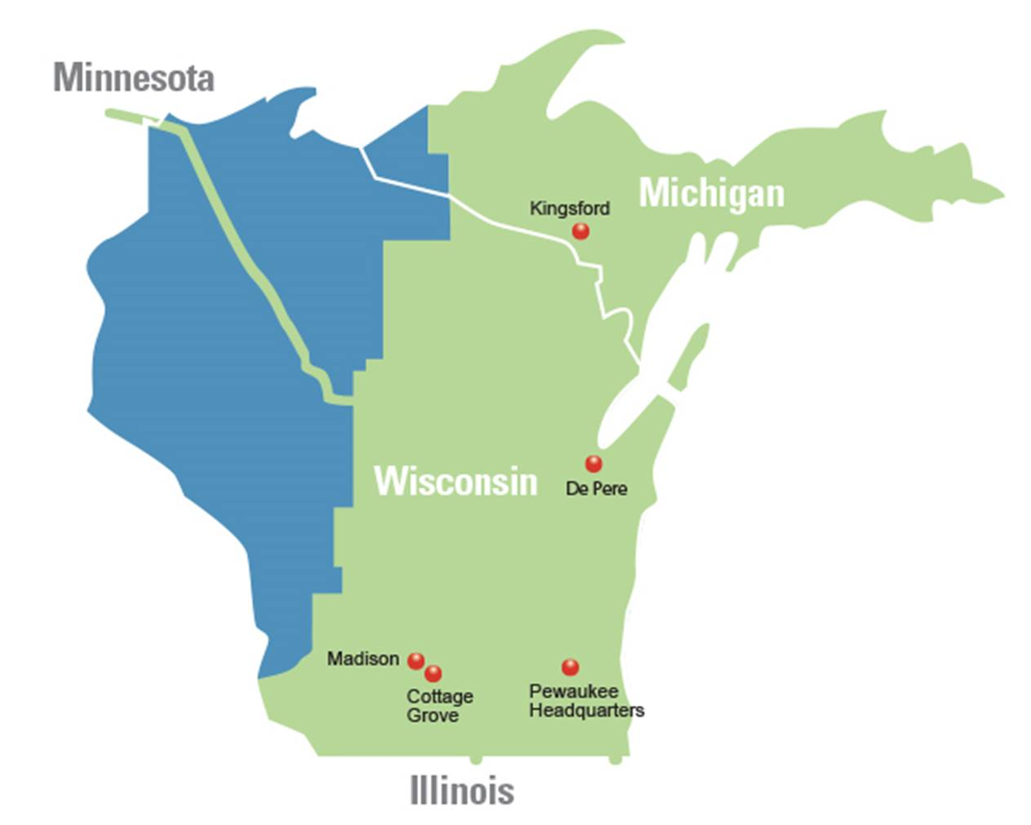
ATC – The Incumbent Transmission Owner
Began operations in 2001 as first multi-state, transmission-only utility in U.S.
Headquartered in Pewaukee, Wisconsin
Privately-held company with 26 owners
Grew from $550 million in assets (net transmission plant) in 2001 to $4.7 billion today
Operating more than 9,600 miles of lines and
554 substations in Wisconsin, Michigan, Minnesota, Illinois

Slide 4
2017 organizational change
Creation of a “sister” structure to formally separate development activities from traditional activities within ATC’s service territory
Certain investor-owned utility members of ATC created own entity to hold investments outside of the service territory (80% common ownership between ATC and “sister” company)
PSCW orders issued 2016
  FERC approval received in 2017
ATC Management, Inc. provides services to both ATC and the “sister” entity through PSC-approved services agreement
DATC, LLC partnership held through ATC DevCo

Slide 5
The ATC focus and impact
Single focus on the transmission system
  No internal competition for resources
  Focused on constructing transmission facilities for:
    Increasing reliability
    Improving access
    Improving market efficiency
    Interconnecting generation
    Fulfilling transmission service requests
    Building infrastructure needed to meet public policy mandates
Transmission costs represent approximately 10 percent of the average customer bill

Slide 6
The ATC obligation
To serve and provide reliable and stable transmission that meets the needs of our utility customers’ more than five million electricity consumers
ATC believes that transmission facilities provide the essential infrastructure that facilitates the efficient working of the wholesale power market
  The focus for ATC is on
    planning
    operating
    building
    maintaining and
    owning the transmission system

Slide 7
The ATC planning process
ATC uses the zone approach to transmission planning assessment, while employing a multi-level planning concept
  The zone approach develops plans that consider all of the multi-level characteristics of ATC’s pricing zone, such as:
    Needs
      existing and new load
    Limitation
      performance of the transmission system
    Developments
      existing and new generation

Slide 8
The ATC planning process (Continued)
Transmission projects are proposed to address reliability, economic efficiency,
multi-benefit, and public policy issues
ATC continues to participate in a variety of efforts to address regional and inter‑regional planning initiatives designed to maintain a reliable system and
capture economic benefits in a dynamic energy marketplace

Slide 9
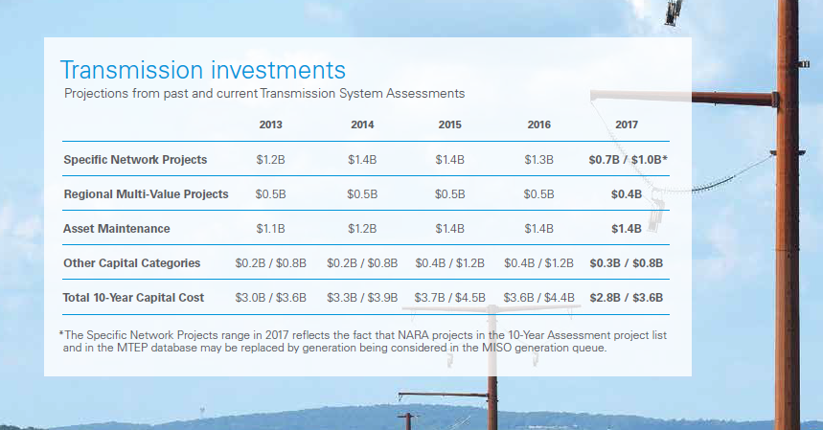
2017 ten-year assessment ($Billions)
For more information on major ATC capital projects, go to
www.atc-projects.com
To view ATC’s ten-year transmission system assessment plan, go to www.atc10yearplan.com
NARA refers to the Northern Area Reliability Assessment

Slide 10
MISO planning process
ATC participates in the MISO Transmission Expansion Planning (MTEP) process as a MISO transmission owner
ATC actively participates in all portions of MISO’s planning efforts, including numerous committees and task forces, in regional and economic study efforts and in development of the MTEP

Slide 11
Attachment FF of the MISO tariff
The MTEP is developed to facilitate the timely and orderly expansion of and/or modification to the transmission system to:
  Maintain reliability
  Promote efficiency in bulk power markets
  Facilitate compliance with applicable federal and state laws, regulatory mandates and regulatory obligations
ATC’s local planning process (resulting in TYA) set forth in Attachment FF-ATCLLC

Slide 12
ATC MTEP 17 projects
ATC has a total of 63 projects in the MTEP17 database
54 projects proposed for Appendix A in MTEP17 ($241M)
9 projects are proposed to move to Appendix B ($159M)

Slide 13
Major projects over $100M ($Millions)
  The Holmes-Old Mead portion of the Bay Lake project was placed in-service in August 2016.
  The North Appleton-Morgan portion is expected to be in-service in the fourth quarter of 2018.
  Badger Coulee is being developed jointly with Northern States Power Wisconsin (Xcel Energy).
  The Cardinal-North Madison portion of the project was placed in service in October 2017.
  Cardinal-Hickory Creek is being developed jointly with ITC-Midwest and Dairyland Power
  Cooperative (DPC).

Slide 14
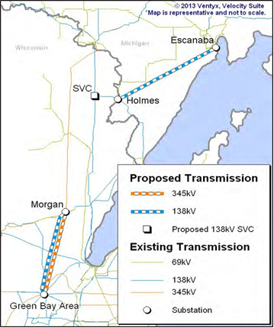
Bay Lake
Overview
  Solves the shifting balance between generation, load and transmission
  Project approved by MISO includes:
    One 138-kV line between the Holmes substation and the Old Mead substation
    345-kV and 138-kV lines from the North Appleton substation to the Morgan substation
  Project cost: Approximately $421 million
Timeline/Status
  2016
    In service – Holmes-Old Mead Road
    Construction began in Wisconsin
  2018
    In service for North Appleton-Morgan projected for October

Slide 15
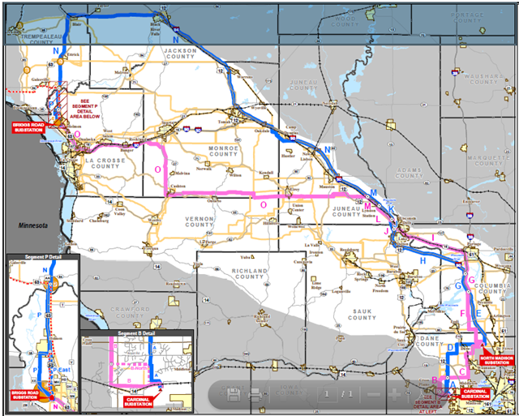
Badger Coulee
Overview
  Approved as a multi-value project (MVP) by MISO in December 2011
  Reliability, economics, renewables
  180 miles, 345-kV line
  Connects to CapX2020 line in La Crosse
  Project cost: Approximately $580 million
  Project is being constructed in segments
  with Northern States Power Wisconsin
  (Xcel Energy).
  Dairyland Power Cooperative, Southern Minnesota Municipal Power Agency- Wisconsin, and WPPI Energy are also owners of the project

Slide 16
Badger Coulee
Timeline/Status
  2015: Order issued by PSCW in April
  2016: Start of construction
  2017
    Cardinal-North Madison segment placed in service
    Army Corps environmental permits for segments 2-4 received May 2017; permits for segments
    5-8 received September 2017
    Town of Holland appealed PSCW decision, including routing and siting, on segment 8
  2018
    Case is at Wisconsin Court of Appeals
    In service

Slide 17
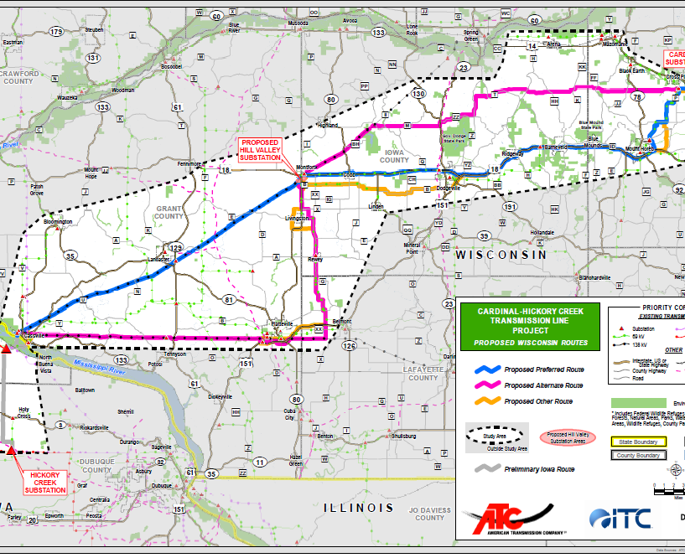
Cardinal-Hickory Creek
Overview
  Approved as a multi-value project (MVP) by MISO in December 2011
  Reliability, economics, public policy
  125 miles of new 345-kV line from Madison to Dubuque County, IA
  Project cost: Approximately $500 million
  Jointly developing the project with ITC-Midwest and Dairyland Power Cooperative
Timeline/Status
  2018: File applications with state regulators
  2019-2020: Anticipated decisions from state regulators
  2023: In service

Slide 18
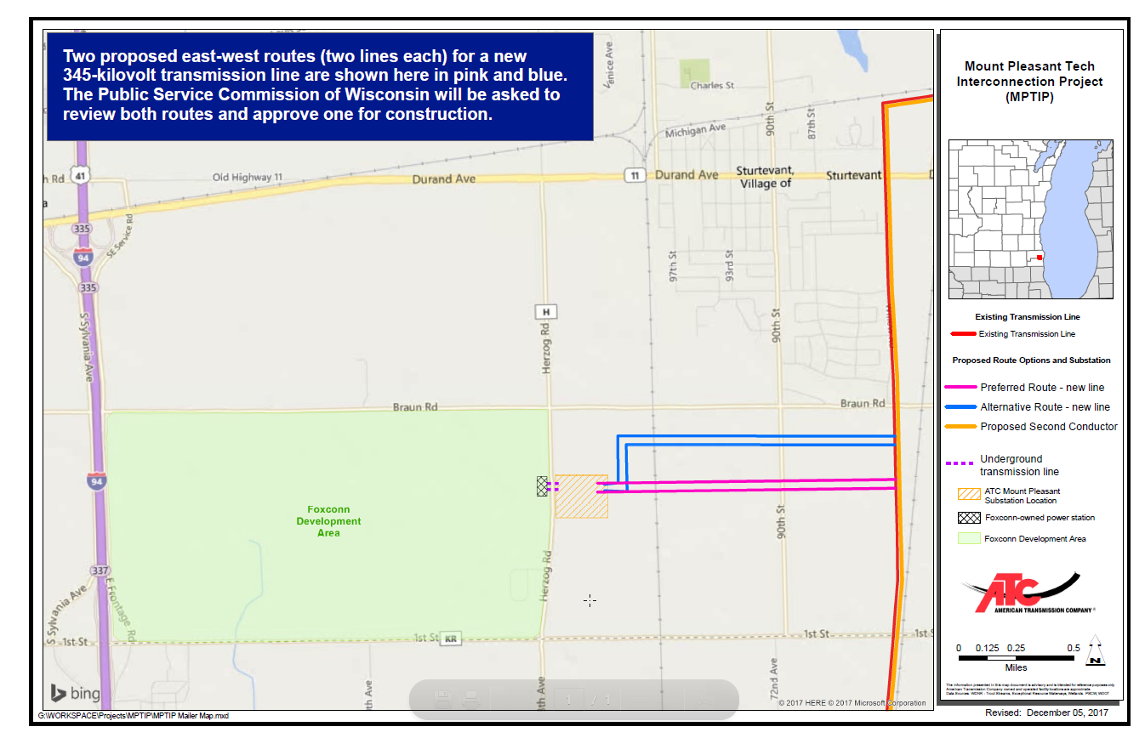
Mount Pleasant Tech interconnection
Overview
  Planned Foxconn manufacturing campus will be the largest manufacturing facility in the country
  Estimated load of approximately 200MW (projected up to 430MW)
  Project requirements
    Two new sets of double-circuit transmission lines (four circuits) along a 1.2-mile corridor
    A second 345-kV transmission circuit to an existing 12-mile transmission line between Racine and Pleasant Prairie
    Construct new Mount Pleasant substation that will connect to a Foxconn-owned substation with an underground 138-kV transmission line
  Project cost: Approximately $117M

Slide 19
Mount Pleasant Tech interconnection (Continued)
Timeline/Status
  2018
    File applications with state regulators and begin public outreach
    Anticipated decisions from state regulators
  2019: Construction start
  2019-2020: In service

Slide 20
2017 Network Revenue Requirement
Actual vs. Billed
(in thousands)

Slide 21
Status of ROE complaints
First complaint (filed November 12, 2013)
  Commission order setting ROE issued September 2016
  10.32% base ROE, 50 BP adder (RTO participation)
  ATC earning 10.82% aggregate ROE until Commission order in second ROE complaint
  ATC provided Schedule 9 network refunds 1Q2017
  MISO completed additional refunds and provided refund report July 2017
Second complaint (filed February 12, 2015)
  ALJ initial decision June 30, 2016
  Base ROE 9.7% (10.2% with adder)
  Refund period: February 12, 2015 – May 11, 2016
ALJ ID awaiting Commission order – Expected 2018(?)

Slide 22
2017 tax cuts and jobs act
Reduction in corporate tax rate to 21%
  As of January 1, 2018 the federal statutory corporate tax rate decreased from 35% to 21%
FERC granted the MISO Transmission Owners (TO) with forward-looking rate formulas a waiver allowing the TOs to reflect the impacts of the new lower federal corporate rate effective January 1, 2018
  ATC network service bills reflect the new rate beginning with the March 2018 service bills invoiced April 1, 2018
    March 2018 network service bills from ATC included tax decrease adjustment for January and February 2018 bills
    MISO re-settled the month of January and February 2018 in the April 2018 billing cycle for regional project bills
  The lower effective tax rate will result in a decrease of approximately $50M in income taxes collected by ATC from customers in 2018

Slide 23
2017 tax cuts and jobs act (Continued)
Excess deferred income taxes
  Deferred taxes were recorded at a higher tax rate than will ultimately be paid by ATC’s owners; ATC will be required to reduce excess taxes
  We expect that this permanent tax savings will be refunded to customers over the regulatory life of the assets via reductions in future taxes collected
  ATC is participating with the MISO TO’s in FERC’s ongoing Federal Income Tax Notice of Inquiry Proceeding to obtain guidance from FERC on administrative details

Slide 24
FERC grid resilience proceeding
Fall 2017
  U.S. Department of Energy Secretary Perry issues Order directing FERC to open rulemaking proceeding to reward “resilience” characteristic
    Coal; nuclear – benefits from fuel stockpile
January 2018
  FERC terminates that proceeding; opens new proceeding on its own motion
    Develop common understanding/definition of “resilience”
    Determine how each RTO/ISO assesses resilience
    Determine whether FERC should act to further resilience
RTO/ISO comments first; then open to public for reply

Slide 25
FERC grid resilience proceeding (Continued)
RTOs generally, and MISO specifically, downplayed resilience concerns
  PJM outlier
Public
  High participation
  Lots of viewpoints
ATC
  Provided input to MISO TO, EEI, and WIRES grid resilience comments
    Electric transmission is important to providing grid resilience

Slide 26
Order No. 1000 – MISO timeline
2011-2012
2015
2016
2018
Future
Order No. 1000 promulgated
FERC-compliant procedure complete
First competitively-bid project (Duff-Coleman MEP)
DATC one of eleven bidders
Second competitively-bid project (Hartburg-Sabine MEP)
Order
No. 1000 in MISO?

Slide 27
Order No. 1000 - May 10, 2018
U.S. House of Representatives Subcommittee on Energy Hearing
“Examining the State of Electric Transmission Infrastructure: Investment, Planning, Construction, and Alternatives”
Tony Clark – former FERC Commissioner
  Order 1000 “burdensome and chaotic” with few projects and data to indicate order success
  Limit Order 1000 to RTO and ISO regions (not deregulated markets) – White Paper
PSEG Chairman, President and CEO Ralph Izzo
  Order 1000 should be repealed – cited PJM’s artificial island project as a disaster
Jennifer Curran – MISO VP
  Order 1000 implementation successful in MISO
  MISO update on Order 1000 - Continuous improvement efforts seek to increase efficiencies, improve transparency and scalability

Slide 28
Order No. 1000
Conclusion/next steps
  FERC review of Order No. 1000?
    FERC Chairman McIntyre said Order No. 1000 “ripe for review”
  Congressional action?
    Fred Upton, R-Mich.
      Order No. 1000 has “all but failed to develop new lines”
    Bobby Rush, D-Ill.
      Order No. 1000 "modifications may be needed to help meet its objective"
Relative FERC Priority?

Slide 29
MISO RECB
In 2016, MISO began to engage stakeholders within the MISO Regional Expansion Criteria and Benefits Working Group (RECBWG) to discuss modifications to cost allocation for market efficiency projects
Over the last year, this effort has evolved and expanded to include considerations of the following project types:
  Market efficiency projects (MEPs)
  Multi-value projects (MVPs)
  Targeted market efficiency projects (TMEPs)
  Interregional market efficiency projects (iMEPs)

Slide 30
MISO RECB (Continued)
Collaborative process with stakeholders, MISO expected to share MISO’s “final” proposed cost allocation proposal at the June 2018 RECB meeting
MISO intends to file tariff changes with FERC in September for an effective date of January 1, 2019, coincident with the conclusion of the MISO South integration

Slide 31
Highlights of MISO RECB proposal
Speculation
MEPs
  Voltage threshold to be reduced from 345 kV to 230kv
    230 kV prevalent in MISO South
  No 20% “postage stamp”
    More granular cost allocation
  Additional benefit metrics
  100-230 kV regional and interregional cost allocation (?)
    Regional – “economic other”
    Interregional: PJM Docket No. EL13-88; SPP?
MVPs: No change

Slide 32
Highlights of MISO RECB proposal (Continued)
Speculation (Continued)
Reliability safeguard
  Similar to PJM; SPP
  Projects with reliability need within three-year “need-by” date exempt from MEP classification
CAZ revision methodology
  MISO and TOs share ability to modify pricing zones
  MISO creating procedure, not substantively changing zones

Slide 33
Thank You!
Questions?
Brian C. Drumm
Manager, Regulatory Relations & Policy and Associate General Counsel
bdrumm@atcllc.com

