Slide 1
Focus on Energy
Tim Dantoin, CP EnMS
Manager LEUP Field Staff
Manager Wisconsin’s SEM Initiative

Slide 2
What is Focus on Energy?
Wisconsin utilities’ statewide program for energy efficiency and renewable energy
Created in 2001 by Act 141 Wis. Stat. § 196.374(2)(a)
Funded by rate payers of state’s investor-owned and participating municipal & co-op utilities
Provides financial and technical support to undertake projects that otherwise would not be implemented.
Notes:
Jolene

Slide 3
Focus on Energy Business Programs
Program | Customer Eligibility
Large Energy Users | Either +1 MW demand or 100,000 therms/month AND > $60,000 monthly energy spend
Business Incentives | Less than 1,000 kW demand
Small Business | Less than 40,000 kWh in July and August
Agricultural, Schools and Government | Except 4 yr campuses and municipal wastewater facilities qualifying as “large” and Ag product mfgs
Design Assistance | New construction bldg envelope and mechanicals
Renewable Energy | Prescriptive incentives solar PV and geothermal and competitive incentives for cost-effective projects

Slide 4
Financial Support
Prescriptive Incentives
specific dollar amount for completing a qualifying energy efficiency measure
2018 incentive catalogs now available online
Custom Incentives
based on energy saved in the first year of operation calculated by Energy Advisor
Customer needs pre-approval before equipment is ordered
$0.03 per kWh and $100 per peak kW
$0.80 per therm
$300,000 per project maximum
$500,000 annual cap per customer
2018 LEUP Summary of Services & Incentives now available

Slide 5
Focus on Energy Advisors (EAs) coordinate with customers, utility account reps and trade allies
Each LEU customer has assigned Energy Advisor
Technical support provided for:
identifying opportunities
quantifying opportunities
applying for incentives
accessing other resources
facilitating energy management
Technical Support

Slide 6
Technical Support
Large Energy User Program (LEUP)
Reginal Advisors & Sector Specialists
Alex Dodd | Madison | 608.819.9032
Bill Lumsden | South West | 608.393.4926
Don Gall | Milwaukee | 262.894.2462
Jeff Fochs | Pulp & Paper Specialist | 715.432.4283
Joe Cantwell | Wastewater Specialist | 262.617.7740
Kevin Kohlbeck | Food Specialist / North East | 920.265.4599
Michael Campos | South Central | 608.215.6403
Paul Kling | South East | 414.232.0693
Randy Urness | North West / Central | 715.498.9607
Richard Feustel | Fox Valley / Lakeshore | 920.517.4712
Steve Lewallen | Metal Casting Specialist | 920.851.9057
Tex Reitter | North Central | 608.512.2702
Tim Hasbargen | Pulp & Paper Specialist | 715.360.6367
Tim Dantoin | SEM / ISO Specialist | 920.366.3744

Slide 7
Strategic Energy Management (SEM)
Improving energy performance by integrating energy considerations into organizational decision-making through the application of continuous improvement principles and practices.

Slide 8
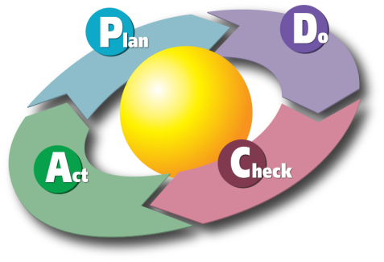
Continuous Improvement
Plan – establish objectives & make plans to achieve them
Do – implement your plans (do what you planned to)
Check – measure your results and compare to objectives
Act – adjust your objectives or improve your plans
ISO - International Organization for Standards
“provides requirements, specifications, guidelines or characteristics that can be used consistently to ensure that materials, products, processes and services are fit for their purpose”

Slide 9
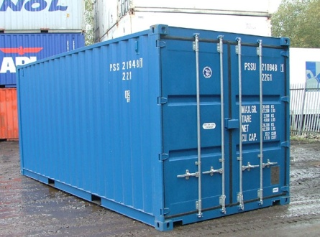
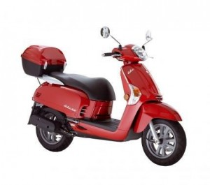
ISO Technical Standards
Shipping Containers
ISO 6346
Film Speed
9848
Credit Cards
ISO 7810
Fasteners
ISO 2
Moped Lighting
ISO 10355

Slide 10
ISO Management Standards
Quality – ISO 9001
Customer Satisfaction – ISO 10003
Environment – ISO 140001
Food Safety – ISO 22000
Social Responsibility – ISO 26000
Information Security – ISO 27001
Supply Chain Security – ISO 28000
Risk Management – ISO 31000
Energy Management – ISO 50001 – June 2011
“Nothing New Under the Sun”

Slide 11
Understanding ISO 50001
“It does not establish absolute requirements for energy performance beyond the commitments in the energy policy of the organization.”
“To enable organizations to establish the systems and procedures necessary to improve energy performance”
“This international standard can be used for certification, registration and self-declaration of an organization’s EnMS.”
aka…”50001 Ready”

Slide 12
Wisconsin SEM “Pilot”
amron

Slide 13
SEM Implementation Process
Period
SEM Partners
•
Develop a regression model of energy use in baseline period
•
Establish process for routine data gathering and performance tracking
•
Complete initial energy review to understand significant energy uses
Zero
to 6
•
identify and implement opportunities for improving energy performance
Months
•
Review existing Energy IT capabilities & opportunities for improvement
•
Evaluate energy savings during performance period
•
Hold management review to assess progress and determine path forward
Discontinue SEM
Remain SEM Partner
Become
SEM Leader
Beyond
6
Stay engaged with Focus
Continue pursuing
Pursue ISO 50001 Ready
EA to pursue
status or 3
Party
Months
opportunities , tracking
rd
opportunities on
case
-
by
-
performance, assess Energy
Certification of SEM
case basis
IT capabilities
efforts

Slide 14
Energy Performance Indicators
Indicator Type | Example
Utility Bill Review | Review Utility Bill Each Month
Year-Over-Year | Aug-2015 vs Aug-2016 = % difference
Energy use Per Part | Monthly Energy Use ÷ Monthly Production = kWh/pound
Regression Model | Daily kWh = 105,000 + (124 * Product A) + (213 * Product B) + (55*CDD) + (-12,000 * Weekend)

Slide 15
Energy Performance Tracking
2017 | kWh | Tons | kWh / Ton
Jan | 3,125,000 | 44,000 | 71.0
Feb | 3,245,000 | 45,000 | 72.1
Mar | 3,300,000 | 47,500 | 69.5
Apr | 3,375,000 | 48,000 | 70.3
May | 3,675,000 | 49,035 | 74.9
Jun | 3,600,000 | 52,500 | 68.6
Jul | 3,950,000 | 52,000 | 76.0
Aug | 3,800,000 | 57,000 | 66.7
Sep | 3,225,000 | 47,250 | 68.3
Oct | 2,950,000 | 42,250 | 69.8
Nov | 3,450,000 | 50,000 | 69.0
Dec | 3,400,000 | 49,500 | 68.7
Total | 40,995,000 | 582,750 | 70.3

Slide 16
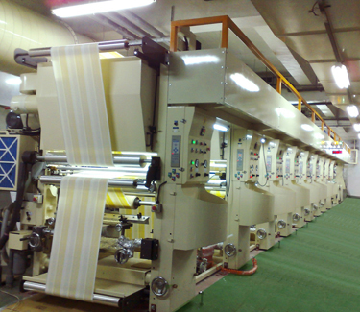
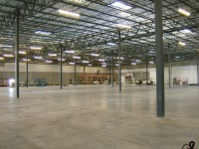
Drivers of Energy Consumption
Weather
Square feet
Production volume
Building occupancy

Slide 17
Regression Analysis
y = mx + b
R² = correlation coefficient
m = energy per variable unit
b = base load
Energy
Use
Variable Load
Base Load
Production Volume

Slide 18
SEM Implementation Process
Period
SEM Partners
•
Develop a regression model of energy use in baseline period
•
Establish process for routine data gathering and performance tracking
•
Complete initial energy review to understand significant energy uses
Zero
to 6
•
identify and implement opportunities for improving energy performance
Months
•
Review existing Energy IT capabilities & opportunities for improvement
•
Evaluate energy savings during performance period
•
Hold management review to assess progress and determine path forward
Discontinue SEM
Remain SEM Partner
Become
SEM Leader
Beyond
6
Stay engaged with Focus
Continue pursuing
Pursue ISO 50001 Ready
EA to pursue
opportunities , tracking
status or 3
Party
Months
rd
opportunities on
case
performance, assess Energy
-
by
-
Certification of SEM
case basis
IT capabilities
efforts

Slide 19
Energy Review
Energy Sources
Electricity - Gas - Coal
Energy Uses
Motors - Pumps - HVAC
Refrigeration - Compressed Air - Steam
Energy Consumption
- Amount of each source used

Slide 20
Energy Review Inventory
Energy Use | Area 1 | Area 2 | Area 3 | Area 4 | Area 5 | Total | % of Plant
Compressed Air |  |  |  |  |  |  | 11%
Facility Cooling |  |  |  |  |  |  | 3%
Facility Heating |  |  |  |  |  |  | 15%
Fans |  |  |  |  |  |  | 5%
Lighting |  |  |  |  |  |  | 2%
Motors |  |  |  |  |  |  | 4%
Process Cooling |  |  |  |  |  |  | 13%
Process Heating |  |  |  |  |  |  | 27%
Pumps |  |  |  |  |  |  | 15%
Total
% of Plant | 8% | 22% | 17% | 13% | 35% |  | 95%
Quantify Energy Consumption
Designate “Significant Energy Uses”

Slide 21
Implementing SEM – Improvement Opportunities
Project Title | Project Status | ID Date | Install Date | Project (Annual) |  |  | Model
 |  |  |  | kW | kWh | Th | kW | kWh | Th
Compressed Air Upgrade | Installed | 3/1/2016 | 12/5/2016 | 9.70 | 14,695 | 0 | 9.70 | 17,147 | 0
2nd Custom Lighting | Pursuing | 11/13/2016 | 12/1/2017 | 16.23 | 84,652 | 0 | 0.00 | 0 | 0
1st Custom Lighting | Installed | 6/4/2015 | 5/15/2016 | 29.20 | 80,706 | 0 | 0.00 | 88,453 | 0
Insulate recover steam pipes | Installed | 1/1/2016 | 4/16/2016 | 0.00 | 0 | 8,154 | 0.00 | 0 | 8,221
Rendering Evap condensate | Installed | 1/1/2016 | 8/1/2016 | 0.00 | 615 | 0 | 0.00 | 549 | 0
New Chilled water | Installed | 2/2/2015 | 10/31/2016 | 0.00 | 669 | 0 | 0.00 | 402 | 0

Slide 22
SEM Implementation Process
Period
SEM Partners
•
Develop a regression model of energy use in baseline period
•
Establish process for routine data gathering and performance tracking
•
Complete initial energy review to understand significant energy uses
Zero
to 6
•
identify and implement opportunities for improving energy performance
Months
•
Review existing Energy IT capabilities & opportunities for improvement
•
Evaluate energy savings during performance period
•
Hold management review to assess progress and determine path forward
Discontinue SEM
Remain SEM Partner
Become
SEM Leader
Beyond
6
Stay engaged with Focus
Continue pursuing
Pursue ISO 50001 Ready
EA to pursue
opportunities , tracking
status or 3
Party
Months
rd
opportunities on
case
performance, assess Energy
-
by
-
Certification of SEM
case basis
IT capabilities
efforts

Slide 23
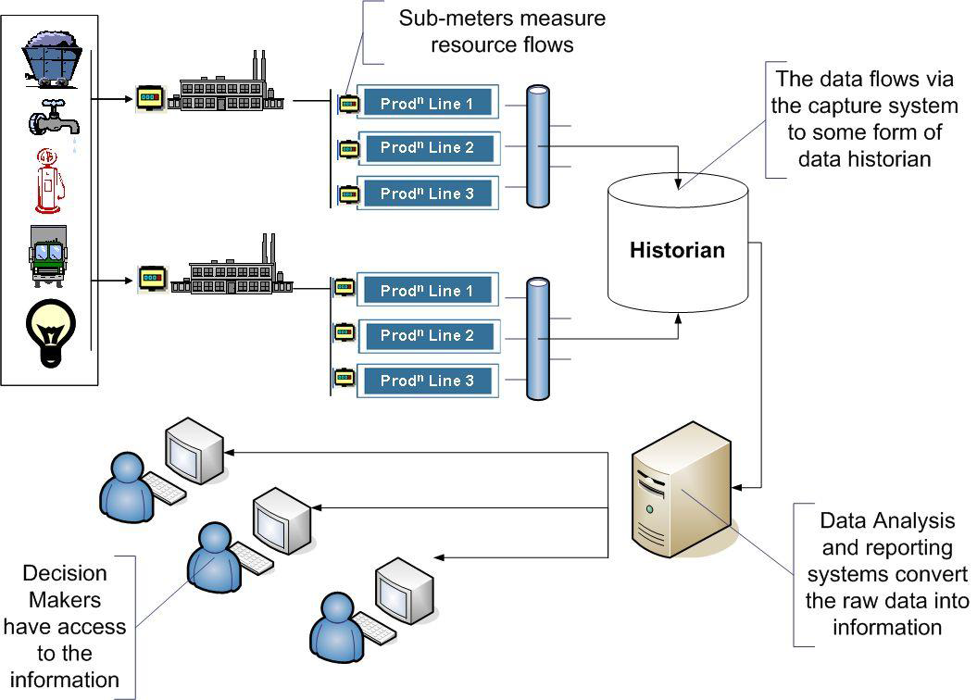
Energy IT – Actionable Information
Data capture system
…for Process Control, Operator Control, Financial Control, Improvement Opportunities Identification, Performance Tracking

Slide 24
Energy IT - Decision Makers
Senior Management – Summary Reports
Process & Cost Owners – Budget Reports
Supervisors – Monitor & Improvement Decisions
Operations & Maintenance – Immediate Action
Data capture system

Slide 25
SEM Implementation Process
Period
SEM Partners
•
Develop a regression model of energy use in baseline period
•
Establish process for routine data gathering and performance tracking
•
Complete initial energy review to understand significant energy uses
Zero
to 6
•
identify and implement opportunities for improving energy performance
Months
•
Review existing Energy IT capabilities & opportunities for improvement
•
Evaluate energy savings during performance period
•
Hold management review to assess progress and determine path forward
Discontinue SEM
Remain SEM Partner
Become
SEM Leader
Beyond
6
Stay engaged with Focus
Continue pursuing
Pursue ISO 50001 Ready
EA to pursue
opportunities , tracking
status or 3
Party
Months
rd
opportunities on
case
performance, assess Energy
-
by
-
Certification of SEM
case basis
IT capabilities
efforts

Slide 26
SEM Performance Tracking – Data Mining
Why?
Baseline
Expected kWh per Week =
(3.66 x Actual Tons) + (46 x Actual CDD) + 47,791 kWh

Slide 27
Implementing SEM – Performance Tracking
1st Lighting Project

Slide 29
SEM Implementation Process
Period
SEM Partners
•
Develop a regression model of energy use in baseline period
•
Establish process for routine data gathering and performance tracking
•
Complete initial energy review to understand significant energy uses
Zero
to 6
•
identify and implement opportunities for improving energy performance
Months
•
Review existing Energy IT capabilities & opportunities for improvement
•
Evaluate energy savings during performance period
•
Hold management review to assess progress and determine path forward
Discontinue SEM
Remain SEM Partner
Become
SEM Leader
Beyond
6
Stay engaged with Focus
Continue pursuing
Pursue ISO 50001 Ready
EA to pursue
opportunities , tracking
status or 3
Party
Months
rd
opportunities on
case
performance, assess Energy
-
by
-
Certification of SEM
case basis
IT capabilities
efforts
35
14

Slide 30
Strategic Energy Management (SEM)
SEM is for you if ….
Use lots of energy (Over 3 MW)
Looking for a more robust approach
Familiar with continuous improvement
Willing to provide energy & production data
Up for an initial 6 month engagement
Have multiple Wisconsin facilities

Slide 31
SEM Process
Our SEM Process
Talk to me, Steve or your Energy Advisor
Get us your data
We develop the Model
Hold kick-off meeting at your facility
Meet monthly to review opportunities & performance
Hold 6 month review with your senior management
Determine next steps

Slide 32
Contact Information
Tim Dantoin
Large Energy Users Program
Wisconsin SEM Initiative
Focus on Energy
Mobile: 920.366.3744
dantoint@leidos.com
focusonenergy.com

