Slide 1
Wisconsin
Department of Natural Resources
WIEG & WCMA Legislative Conference
March 7, 2018
Wisconsin DNR Program Updates
Bart Sponseller
Deputy Division Administrator
Environmental Management Division
Wisconsin Department of Natural Resources

Slide 2
Air Program Topics
Wisconsin
Department of Natural Resources
EPA items on the horizon (ozone implementation, “once in always in” policy, NSR reform, monitoring citizen science)
1-hour NO₂ NAAQS Implementation
Addressing PM2.5 in Permits
Collaborative permit process

Slide 3
Wisconsin
Department of Natural Resources
2015 Ozone NAAQS Designations
In September 2016, Gov. Walker recommended that all counties in Wisconsin be designated as attainment of the 2015 ozone NAAQS (70 ppb).
In April 2017, DNR submitted additional information supported the recommendation including data showing the impact of transport on state ozone levels and the maximum extent of 70 ppb design values in the state.
On November 6, EPA designated all but 16 counties in Wisconsin as attainment/unclassifiable for the 2015 ozone NAAQS; EPA deferred action on the 16 counties.

Slide 4
Wisconsin
Department of Natural Resources
2015 Ozone NAAQS Designations
On December 20, 2017 EPA took action on the remaining counties, proposing to designate them all as attainment/unclassifiable except for:
Kenosha County (partial)
Washington, Waukesha, Ozaukee, Milwaukee, and Racine counties
Sheboygan County (partial), Manitowoc County (partial), Door County (partial)
On Feb. 28, state submitted additional technical information for EPA to consider. EPA also received many comments from state organizations asking that any nonattainment areas be smaller than those proposed by EPA.
Between April 19-30, 2018, EPA is expected to finalize designations.
Nonattainment new source review permitting requirements (including LAER, offsets…) will apply in any nonattainment areas, once finalized.

Slide 5
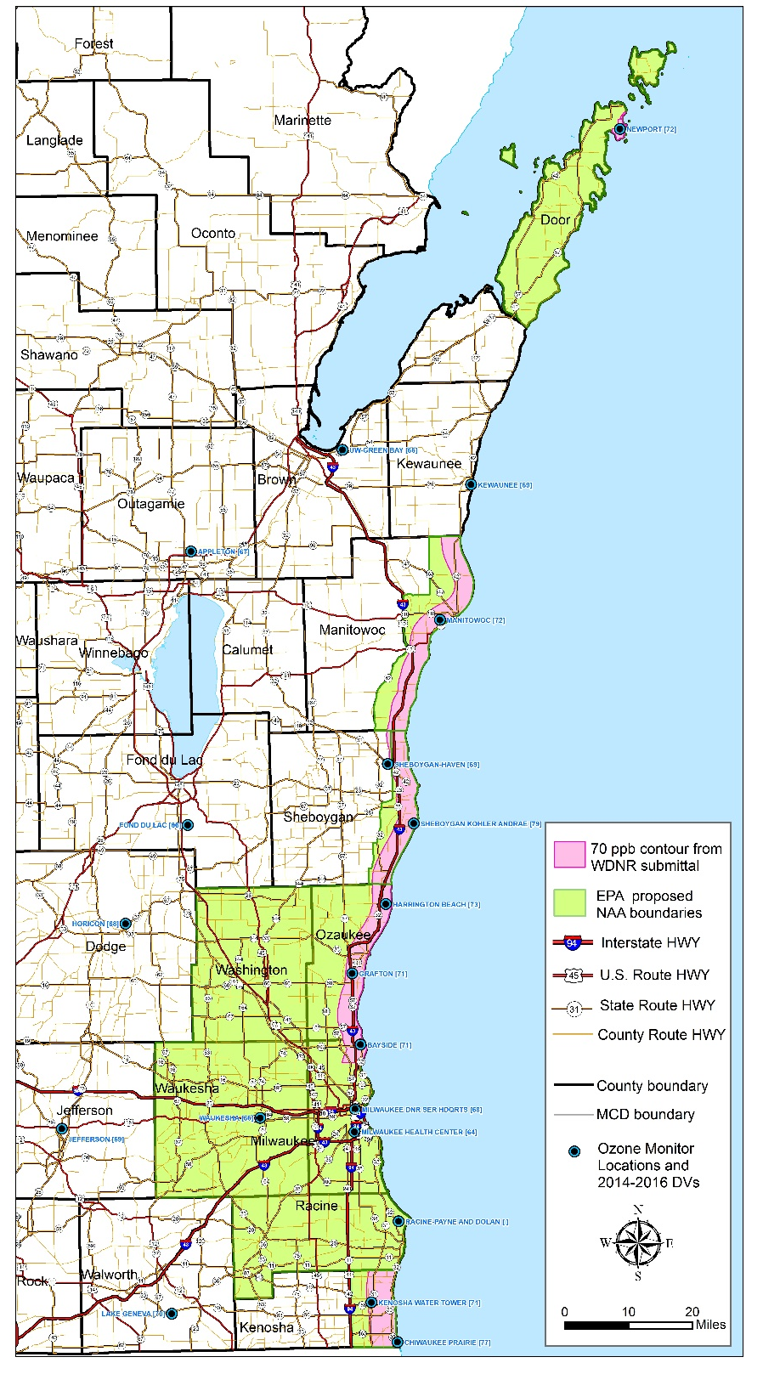
Wisconsin
Department of Natural Resources
EPA’s Intended 2015 Ozone NAAQS Nonattainment Area Designations
All areas of Wisconsin
Data from EPA’s 120-day letter of 12/20/17 and
DNR submittal to EPA of 4/20/17

Slide 6
Ozone standards implementation
Wisconsin
Department of Natural Resources
EPA is currently implementing two ozone standards
2008 ozone NAAQS (75 ppb)
2015 ozone NAAQS (70 ppb)
State has continued responsibilities re: two 2008 ozone NAAQS nonattainment areas
Sheboygan County and partial Kenosha County
DNR continues to work with EPA to develop strategies to ensure these areas attain the 2008 ozone standard

Slide 7
Ozone transport
Wisconsin
Department of Natural Resources
Studies and analyses continue to show the elevated ozone levels measured along the Wisconsin lakeshore are due to out of state emissions
Example (right) of wind pollution rose analysis and source apportionment modeling results for Sheboygan Kohler-Andrae monitoring site

Slide 8
Once In Always In Policy
Wisconsin
Department of Natural Resources
Once in always in policy affects facilities subject to maximum achievable control technology (MACT) standards
Old policy from May 1995 “Seitz Memo”
A major source of hazardous air pollutants (HAPs) is permanently subject to the MACT standard at the “first compliance date” of the standard even if the source is later able to limit its HAP emissions below the major source thresholds

Slide 9
Wisconsin
Department of Natural Resources
Once In Always In Policy
New Policy - January 25, 2018
A major source may take enforceable limits on its HAP emissions below the applicable major source thresholds for HAPS
Once limits are taken, the source is no longer subject to the MACT standard
EPA will publish a Federal Register notice to take comment on adding regulatory text that will reflect EPA’s plain language reading of the statute

Slide 10
NSR reform
Wisconsin
Department of Natural Resources
Lawmakers are looking to “ease the burden of EPA's new source review (NSR) air permitting program”
EPA responded with a December 7, 2017 memo deferring to industry's projections of likely emissions increases
For facilities using projected actuals to show that a project does not require review under PSD
EPA will not question a facility’s emission projections but will rely on post construction information to determine if projection was accurate
EPA expects this to be the 1st memo in a series of NSR reforms

Slide 11
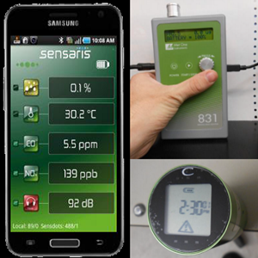
Wisconsin
Department of Natural Resources
EPA items on the horizon – Air monitoring citizen science
Citizen science and low cost sensor technology
EPA making an effort to support citizen science efforts
sensor toolbox
standards for sensor technology

Slide 12
1-Hour NO₂ NAAQS
Wisconsin
Department of Natural Resources
Published in Wisconsin Administrative Code August 1, 2016
Criteria for permit approvability in Wisconsin Statute:
Air program may not issue a permit unless if finds that the source cannot cause or exacerbate a violation of NAAQS

Slide 13
NO₂ NAAQS in Permit Reviews
Wisconsin
Department of Natural Resources
DNR will use dispersion modeling to evaluate NO_{x} emissions for the 1-hour NO₂ standards for the following application types:
Major construction permit reviews under Prevention of Significant Deterioration
Modeling submitted with application as required in ch. NR 405
Updated Ambient Ratio Method for conversion of NO_{x} to NO₂ to be used
Updated 40 CFR Part 51 Appendix W to be used
Other permits at facilities with large fuel combustion units:
National Emissions Inventory lists coal fired electric generating units and coal fired industrial boilers as the only significant stationary source contributors to NO_{x} emissions
Use PSD source category as a size threshold

Slide 14
Wisconsin
Department of Natural Resources
NO₂ NAAQS in Permit Reviews
DNR will use a weight of evidence approach to evaluate NO_{x} emissions for the 1-hour NO₂ standards for all other application types:
Weight of evidence of the impact industrial stationary sources have on ambient NO₂ concentrations:
Mobile sources, such as motor vehicles, are the primary source of NO_{x} emissions (approximately 60%) that contribute to ambient 1-hour NO₂ concentrations.
Approximately 80 percent of the NO_{x} emissions in Wisconsin come from sources that are not industrial stationary sources regulated by air pollution control permits.
NO_{x} emissions from industrial sources are decreasing over time due to more restrictive regulations and advances in technology.

Slide 15
Wisconsin
Department of Natural Resources
NO₂ NAAQS in Permit Reviews
Weight of evidence based on ambient air quality monitoring shows:
All portions of the United States are in attainment with the 1-hour NO₂ NAAQS
Wisconsin, Minnesota, Iowa, and Illinois have NO₂ concentrations of less than 75% of the 1-hour NAAQS, including the heavily populated Chicago metropolitan area and concentrations are steadily decreasing
Ambient 1-hour NO₂ concentrations show a consistent downward trend nationwide
The regulation of industrial stationary sources of NO_{x}, as well as advances in technology, is expected to further decrease ambient concentrations of NO₂

Slide 16
Wisconsin
Department of Natural Resources
NO₂ NAAQS Implementation
Guidance on NO₂ has been drafted including:
Memo to permit writers: decision tree on when to use dispersion modeling and when to use weight of evidence
Attachment to Wisconsin Modeling Guidelines containing references and technical information used to support weight of evidence
DNR posted guidance on September 29, 2017 and took public comment for 21 days
DNR is preparing the final guidance and response to comments
Final guidance is expected the first quarter of 2018

Slide 17
PM_{2.5} in Air Permits
Wisconsin
Department of Natural Resources
New approach – treat PM_{2.5} like ozone
Make a finding using a “weight of evidence” approach, that standards are protected
State-wide ambient monitoring data demonstrates that PM_{2.5} behaves like a “regional” pollutant
Concentrations vary similarly across vast areas
Analysis of ambient monitoring filters showing PM_{2.5} is mostly from secondary formation
Direct emissions from stationary sources are MUCH lower than reported
Notes:
17

Slide 18
Wisconsin
Department of Natural Resources
PM_{2.5} in Air Permits
The only regulatory requirement for PM_{2.5} is the ambient air quality standards
When is PM_{2.5} limit in a permit?
Limits established to keep emissions below major modification thresholds, i.e. major NSR avoidance
Limits established as BACT or LAER in major NSR
Limits established at a level shown by a model to protect a standard
Notes:
18

Slide 19
Wisconsin
Department of Natural Resources
Permitting Implications
PM_{2.5} permitting: minor sources
PM_{2.5} limits will not appear in most minor source permits;
Exceptions: Previously established limits
PSD avoidance limits
Guidance provided on calculating PM_{2.5} emissions for permit writers and permit applicants.
Accurate emissions estimates of PM_{2.5} emissions are essential
Fuel combustion\high temperature processes

Slide 20
Wisconsin
Department of Natural Resources
Permitting Implications
PM_{2.5} permitting: major PSD sources
PM_{2.5} major modification avoidance limits will still be needed
PM_{2.5} will need to be in netting analyses
PM_{2.5} will be modeled as required in federal law
Even for PSD – accurate PM_{2.5} estimates are essential
Fuel combustion and high temperature processes.
Consider additional information or data if presented

Slide 21
Wisconsin
Department of Natural Resources
Summary and Next Steps
Concentrations of PM_{2.5} have and continue to decrease due to appropriate regulation of PM_{2.5} precursors and sources
There are alternatives to dispersion modeling for determining whether a source’s emissions are protective of the NAAQS
Review recurring issues with EPA
Continually review and revisions to guidance on PM_{2.5} as needed

Slide 22
Collaborative Permit Process
Wisconsin
Department of Natural Resources
Guidance on Collaborative Permit Process – Submitting a Redline Strikeout Version of an Existing Permit as Part of an Application
Encourages facility submitting a permit application to include an edited version of an existing permit
Shows permit applicants how to obtain editable versions of their permit documents
Lists types of conditions that DNR cannot change
Goal is to facilitate communication and increase overall efficiency of the permit process
Posted on February 22, 2018 and is available for 21 day comment through March 13, 2018 http://dnr.wi.gov/news/input/guidance.html

Slide 23
Wisconsin
Department of Natural Resources
Waste & Materials Management
Program Update

Slide 24
WMM Program Topics
Wisconsin
Department of Natural Resources
Rule Revisions
NR 538 – Beneficial Reuse
NR 600 series - Hazardous Waste
Legislation
Exemption for iron & steel slag
Pyrolysis & Gasification exemption

Slide 25
NR 538 Overview
Wisconsin
Department of Natural Resources
NR 538.03(4) Specific high-volume industrial byproducts:
Paper mill sludge
Coal ash
Flue gas desulfurization material (FGD)
Foundry sand & slag
Lime kiln dust
Other non-hazardous solid waste with similar characteristics

Slide 26
Material Use
Wisconsin
Department of Natural Resources
Specific uses of industrial byproduct allowed based on byproduct Category
Category 1 = few restrictions on use
Category 5 = most restrictions on use & placement

Slide 27
NR 538 Revision
Wisconsin
Department of Natural Resources
TAC has met 7 times since spring 2016
Emphasis on keeping successful framework
Simplify process
Largely self-implementing
Expand number of approved uses
Improve material tracking

Slide 28
Hazardous Waste Regulation Revisions
Wisconsin
Department of Natural Resources
Generator improvement rule
Definition of solid waste
e-Manifest

Slide 29
Wisconsin
Department of Natural Resources
Legislation
Exemption for iron and steel slag
SB 792/AB941
Status: Passage as amended; available for scheduling
Pyrolysis and gasification exemption
SB646/AB789
Status: Passage as amended; available for scheduling

Slide 30
Wisconsin
Department of Natural Resources
Questions?
Bart Sponseller
608-266-0014

